Slide 1
Scams, Hustles, and Other “Fair” Games
Arthur T. Benjamin
Smallwood Family Professor of Mathematics
Harvey Mudd College

Slide 2
Who will win tomorrow’s baseball game?
Sophisticated Mathematical Model

Slide 3
Who will tomorrow’s baseball game?
Sophisticated Mathematical Model
Outcome is 150% Guaranteed!
Should you take this bet?

Slide 4
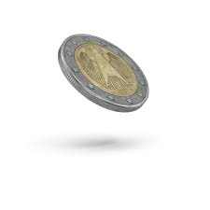
I flip a coin.

Slide 5
I flip a coin.
Remember: When I return $15,
$10 of that was yours to begin with!

Slide 6
My Expected Value
EV = ½(10) + ½(–5) = 2.50
If I can actually predict better than the coin, then my EV goes up even more.

Slide 7
There are some good mathematical models for making sports predictions.
Example: An accurate method for predicting the score of a baseball game before it begins.

Slide 8
Disclaimer!

Slide 9
SIMPLE DICE GAME….
Played with 6-sided dice, but not with the traditional numbers.

Slide 10
A = 6, 6, 2, 2, 2, 2
B = 3, 3, 3, 3, 3, 3
C = 4, 4, 4, 4, 0, 0
D = 5, 5, 5, 1, 1, 1
We each pick a die.
Whoever rolls the higher number wins.
Which die would you like?

Slide 11
A = 6, 6, 2, 2, 2, 2
B = 3, 3, 3, 3, 3, 3
C = 4, 4, 4, 4, 0, 0
D = 5, 5, 5, 1, 1, 1
If you pick A, then I’ll pick B since
P(B > A) = 2/3

Slide 12
A = 6, 6, 2, 2, 2, 2
B = 3, 3, 3, 3, 3, 3
C = 4, 4, 4, 4, 0, 0
D = 5, 5, 5, 1, 1, 1
If you pick B, then I’ll pick C since
P(C > B) = 2/3

Slide 13
A = 6, 6, 2, 2, 2, 2
B = 3, 3, 3, 3, 3, 3
C = 4, 4, 4, 4, 0, 0
D = 5, 5, 5, 1, 1, 1
If you pick C, then I’ll pick D since
P(D > C) = 2/3
Why?

Slide 14
A = 6, 6, 2, 2, 2, 2
B = 3, 3, 3, 3, 3, 3
C = 4, 4, 4, 4, 0, 0
D = 5, 5, 5, 1, 1, 1
D can win in 2 ways.
Either: D = 5, with probability 1/2
OR
D = 1 & C = 0 with probability (1/2)(1/3)=1/6
Thus, P(D > C) = 1/2 + 1/6 = 2/3

Slide 15
A = 6, 6, 2, 2, 2, 2
B = 3, 3, 3, 3, 3, 3
C = 4, 4, 4, 4, 0, 0
D = 5, 5, 5, 1, 1, 1
If you pick D then I’ll pick A since
P(A > D) = 2/3
Why?

Slide 16
A = 6, 6, 2, 2, 2, 2
B = 3, 3, 3, 3, 3, 3
C = 4, 4, 4, 4, 0, 0
D = 5, 5, 5, 1, 1, 1
A = 6, with probability 1/3
OR
A = 2 & D = 1, with probability (2/3)(1/2) = 1/3
P(A > D) = 1/3 + 1/3 = 2/3

Slide 17
To summarize, we have
A loses to B,
B loses to C,
C loses to D, and yet
D loses to A,
each with probability 2/3.
Non-transitive probabilities.

Slide 18
Sounds impossible.
Most competitive situations are transitive.
If A is faster than B and B is faster than C, then A is faster than C.

Slide 19
We encounter non-transitive situations in games like Rock Paper Scissors:
Rock beats Scissors
Paper beats Rock
Scissors beats Paper

Slide 20
Rock Paper Scissors
 | Rock | Paper | Scissors
Rock | 0 | -1 | 1
Paper | 1 | 0 | -1
Scissors | -1 | 1 | 0

Slide 21
Rock, Paper, Scissors, Lizard, Spock
 | Rock | Paper | Scissors | Lizard | Spock
Rock | 0 | -1 | 1 | 1 | -1
Paper | 1 | 0 | -1 | -1 | 1
Scissors | -1 | 1 | 0 | 1 | -1
Lizard | -1 | 1 | -1 | 0 | 1
Spock | 1 | -1 | 1 | -1 | 0

Slide 22
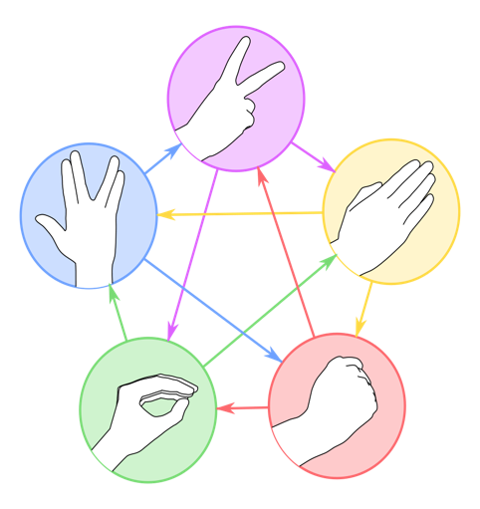

Slide 23
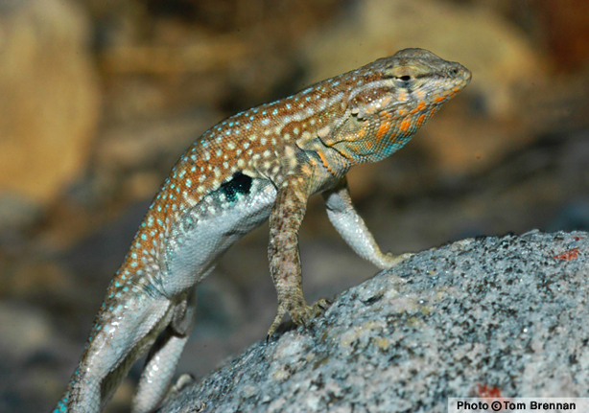
When male lizards compete for females among common side blotched lizards: Orange beats Blue; Blue Beats Yellow; Yellow beats Orange.

Slide 24
A Sneakier Scam
Red = 2, 2, 2, 11, 11, 14
White = 0, 3, 3, 12, 12, 12
Blue = 1, 1, 1, 13, 13, 13
Choose your color and mine!
What could be fairer than that?

Slide 25
Red = 2, 2, 2, 11, 11, 14
White = 0, 3, 3, 12, 12, 12
Blue = 1, 1, 1, 13, 13, 13
It can be shown that
R < W < B < R
P(R < W) > ½
P(W < B) > ½
P(B < R) > ½

Slide 26
Red = 2, 2, 2, 11, 11, 14
White = 0, 3, 3, 12, 12, 12
Blue = 1, 1, 1, 13, 13, 13
But if you roll 2 dice of the same color and take their total, then the situation is completely reversed!

Slide 27
Red = 2, 2, 2, 11, 11, 14
White = 0, 3, 3, 12, 12, 12
Blue = 1, 1, 1, 13, 13, 13
R < W < B < R
2R > 2W > 2B > 2R
In fact, when you roll 3 dice of the same color, the probabilities switch back again!
3R < 3W < 3B < 3R

Slide 28
R < W < B < R
2R > 2W > 2B > 2R
You choose both of our colors, but I didn’t say how many of each color we would roll!

Slide 29
Penney Ante
Flip a coin 3 times. 8 equally likely outcomes:
HHH HHT HTH HTT
THH THT TTH TTT
Whichever sequence shows up first is the winner. Which one would you like?

Slide 30
Suppose you pick the pattern HHH.
Then I’ll pick the pattern THH and I’m an enormous favorite.
Why?

Slide 31
For any sequence of coin flips, and look for when the sequence HHH first appears.
HTTTHTHHHTTHH….

Slide 32
For any sequence of coin flips, and look for when the sequence HHH first appears.
HTTTHTHHHTTHH….
HTTTHTHHHTTHH….

Slide 33
How can you win?
Only if the coin flips immediately starts with
HHH….
which happens only 1/8 of the time.
Thus P(THH beats HHH) = 7/8

Slide 34
If you choose sequence ABC
(where each letter stands for a coin flip) then I choose the sequence
B’AB,
where B’ denotes the opposite of B.

Slide 35
If you choose sequence ABC
(where each letter stands for a coin flip) then I choose the sequence
B’AB,
where B’ denotes the opposite of B.
If you choose THH
Then I choose TTH.

Slide 36
ABC loses | to B’AB | probability
HHH | THH | 7/8 = .875
HHT | THH | 3/4 = .750
HTH | HHT | 2/3 = .667
HTT | HHT | 2/3 = .667
THH | TTH | 2/3 = .667
THT | TTH | 2/3 = .667
TTH | HTT | 3/4 = .750
TTT | HTT | 7/8 = .875

Slide 37
Explain P(THH beats HHT) = ¾
There are 4 ways that the game can start:
HH
HT
TH
TT

Slide 38
Explain P(THH beats HHT) = ¾
There are 4 ways that the game can start:
HH HHT Wins (once a tail appears)
HT
TH
TT

Slide 39
Explain P(THH beats HHT) = ¾
There are 4 ways that the game can start:
HH HHT Wins (once a tail appears)
HT THH Wins other 3, since
TH
TT

Slide 40
Explain P(THH beats HHT) = ¾
There are 4 ways that the game can start:
HH HHT Wins (once a tail appears)
HT THH Wins other 3, since
TH as soon as a T appears, the first
TT HH must be preceded by a T.

Slide 41
Why does THH (usually) beat HHT?
For any sequence of coin flips, and look for when the sequence HH first appears.
HTTTHTHHHTTHH….
HTTTHTHHHTTHH….

Slide 42
Why does THH (usually) beat HHT?
For any sequence of coin flips, and look for when the sequence HH first appears.
HTTTHTHHHTTHH….
HTTTHTHHHTTHH….
HHT can only win if it starts with HH.

Slide 43
ABC loses | to B’AB | probability
HHH | THH | 7/8 = .875
HHT | THH | 3/4 = .750
HTH | HHT | 2/3 = .667
HTT | HHT | 2/3 = .667
THH | TTH | 2/3 = .667
THT | TTH | 2/3 = .667
TTH | HTT | 3/4 = .750
TTT | HTT | 7/8 = .875

Slide 44
Why is P(HHT beats HTH) = 2/3?
Flipping a Tail at the beginning does not help either player, so we flip the coin until we get our first Head.
H
Then we look at the next two flips, so there are 4 relevant possibilities.

Slide 45
Explain P(HHT beats HTH) = 2/3
HTH
HHT
HHH
HTT

Slide 46
Explain P(HHT beats HTH) = 2/3
HTH
HHT
HHH
HTT

Slide 47
Explain P(HHT beats HTH) = 2/3
HTH HTH wins immediately
HHT
HHH
HTT

Slide 48
Explain P(HHT beats HTH) = 2/3
HTH HTH wins immediately
HHT
HHH
HTT

Slide 49
Explain P(HHT beats HTH) = 2/3
HTH HTH wins immediately
HHT HHT wins immediately
HHH
HTT

Slide 50
Explain P(HHT beats HTH) = 2/3
HTH HTH wins immediately
HHT HHT wins immediately
HHH
HTT

Slide 51
Explain P(HHT beats HTH) = 2/3
HTH HTH wins immediately
HHT HHT wins immediately
HHH HHT wins eventually
HTT

Slide 52
Explain P(HHT beats HTH) = 2/3
HTH HTH wins immediately
HHT HHT wins immediately
HHH HHT wins eventually
HTT

Slide 53
Explain P(HHT beats HTH) = 2/3
HTH HTH wins immediately
HHT HHT wins immediately
HHH HHT wins eventually
HTT back to the drawing board…

Slide 54
Explain P(HHT beats HTH) = 2/3
HTH HTH wins immediately
HHT HHT wins immediately
HHH HHT wins eventually
HTT back to the drawing board…
HHT wins in 2 of the 3 scenarios.

Slide 55
Texas Hold’em Example

Slide 56
Suppose I gave you the choice of
picking as your initial two cards:
2S 2H or JD 10D or AC KS
Which one would you like? I’ll take one of the others.

Slide 57
According to the poker calculators:
P(22 beats AK) ≈ 53%

Slide 58
According to the poker calculators:
P(22 beats AK) ≈ 53%
P(J10s beats 22) ≈ 53%

Slide 59
According to the poker calculators:
P(22 beats AK) ≈ 53%
P(J10s beats 22) ≈ 53%
P(AK beats J-10s) ≈ 59%

Slide 60
According to the calculators:
P(22 beats AK) ≈ 53%
P(J10s beats 22) ≈ 53%
P(AK beats J-10s) ≈ 59%
AK < 22 < J10s < AK
Non-transitive probabilities

Slide 61
New Wager
From a shuffled deck of 50 cards:
26 winners (red) and 24 losers (black).
You start with $100 and on each bet, you bet 10% of your bankroll.
(First bet is $10; next be is $11 or $9.)

Slide 62
After each bet your money is multiplied by 1.1 or .90.
After 26 wins and 24 losses, you are guaranteed to have

Slide 63
After each bet your money is multiplied by 1.1 or .90.
After 26 wins and 24 losses, you are guaranteed to have
$100(1.1)²⁶(.90)²⁴
= $100(.99)²⁴(1.1)²
= $95.07

Slide 64
Even worse: If you bet 20% of your bankroll…
After 26 wins and 24 losses, you are guaranteed to have
$100(1.20)²⁶(.80)²⁴
= $100(.96)²⁴(1.2)²
= $54.06

Slide 65
You can win this game if you bet a smaller percentage of your bank roll. The Kelly Criterion says that the optimal strategy is to “bet your edge”. If you win 26/50 = 52% and you lose 24/50 = 48%, then you should bet 52% – 48% = 4%.

Slide 66
Betting 4% of your bankroll is profitable.
After 26 wins and 24 losses, you are guaranteed to have
$100(1.04)²⁶(.96)²⁴
= $100(.9984)²⁴(1.04)²
= $104.08

Slide 67
The Multiplication Game
You and I each choose a secret 4-digit number. We then reveal our numbers and multiply them together.
If the product begins with 1, 2, or 3, then I win.
If it begins with 4, 5, 6, 7, 8, or 9, then you win.

Slide 68
The Multiplication Game
You and I each choose a secret 4-digit number. We then reveal our numbers and multiply them together.
If the product begins with 1, 2, or 3, then I win.
If it begins with 4, 5, 6, 7, 8, or 9, then you win. SOUND FAIR?

Slide 69
The Multiplication Game
You and I each choose a secret 4-digit number. We then reveal our numbers and multiply them together.
If the product begins with 1, 2, or 3, then I win.
If it begins with 4, 5, 6, 7, 8, or 9, then you win. LET’S PLAY!

Slide 70
The Multiplication Game
Believe it or not, I have a strategy that wins 60% of the time.
The strategy is based on….

Slide 71
Benford’s Law
For many sets of numbers that arise in the real world, we tend to see more numbers that begin with small digits instead of large digits.

Slide 72
Benford’s Law
For many sets of numbers that arise in the real world, we tend to see more numbers that begin with small digits instead of large digits.
Specifically under Benford’s Law, the probability that a number starts with digit d is log(d+1) – log(d)

Slide 73
Benford’s Law
Leading Digit | Probability | Numerical
1 | log 2 | .301
2 | log 3 – log 2 | .176
3 | log 4 – log 3 | .125
4 | log 5 – log 4 | .097
5 | log 6 – log 5 | .079
6 | log 7 – log 6 | .067
7 | log 8 – log 7 | .058
8 | log 9 – log 8 | .051
9 | log 10 – log 9 | .046
Total | log 10 | 1.000

Slide 74
Examples of Benford’s Law
Leading Digit | 1 | 2 | 3 | 4 | 5 | 6 | 7 | 8 | 9
Benford | .301 | .176 | .125 | .097 | .079 | .067 | .058 | .051 | .046
Powers of 2 | .301 | .176 | .125 | .097 | .079 | .067 | .058 | .051 | .046
Fibonacci Numbers | .301 | .176 | .125 | .097 | .079 | .067 | .058 | .051 | .046
Data from first 10,000 powers of 2 and
first 10,000 Fibonacci Numbers

Slide 75
Examples of Benford’s Law
Also applies to leading digits of powers of almost all numbers, values of n! but not the sequence of prime numbers, square roots, or perfect squares.
Also seems to show up in real world data such as addresses, distances, and lists of physical constants. (DEMO)

Slide 76
Other descriptions of Benford’s Law
P(Leading digit = d) = log(d+1) – log(d)

Slide 77
Other descriptions of Benford’s Law
P(Leading digit = d) = log(d+1) – log(d)
P(Leading digit ≤ d) = log(d+1)
Example:
P(Leading digit ≤ 3) = log 4 = 0.602

Slide 78
Benford’s Law
Leading Digit | Probability | Numerical
1 | log 2 | .301
2 | log 3 – log 2 | .176
3 | log 4 – log 3 | .125
4 | log 5 – log 4 | .097
5 | log 6 – log 5 | .079
6 | log 7 – log 6 | .067
7 | log 8 – log 7 | .058
8 | log 9 – log 8 | .051
9 | log 10 – log 9 | .046
Total | log 10 | 1.000

Slide 79
Continuous Model of Benford’s Law
Choose a real number X from (1, 10) so that
for 1 ≤ s < 10
P(X < s) = log s

Slide 80
Continuous Model of Benford’s Law
Choose a real number X from (1, 10) so that
for 1 ≤ s < 10
P(X < s) = log s
Note P(Leading digit of X = d)
= P(X < d + 1) – P(X < d)
= log(d+1) – log(d)

Slide 81
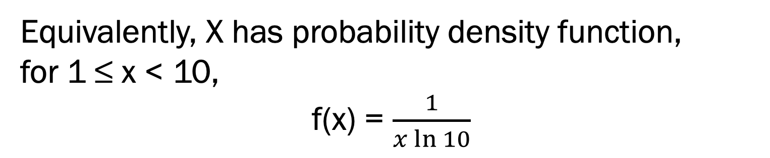
Continuous Models of Benford’s Law
Equivalently, X has probability density function,
for 1 ≤ x < 10,
f(x) = $\frac{1}{x\ln{10}}$

Slide 82
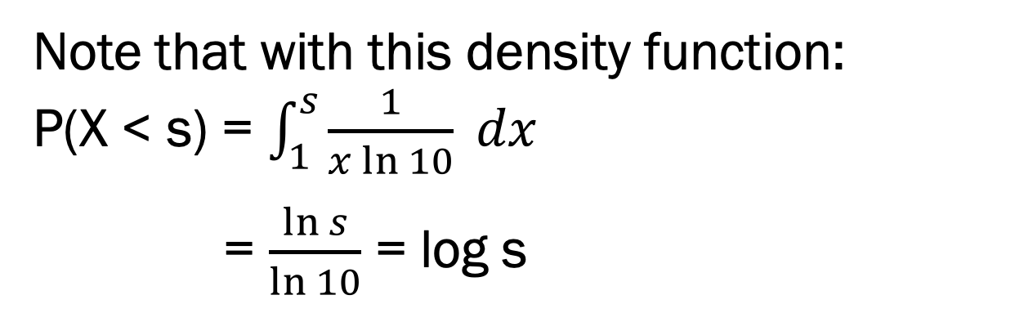
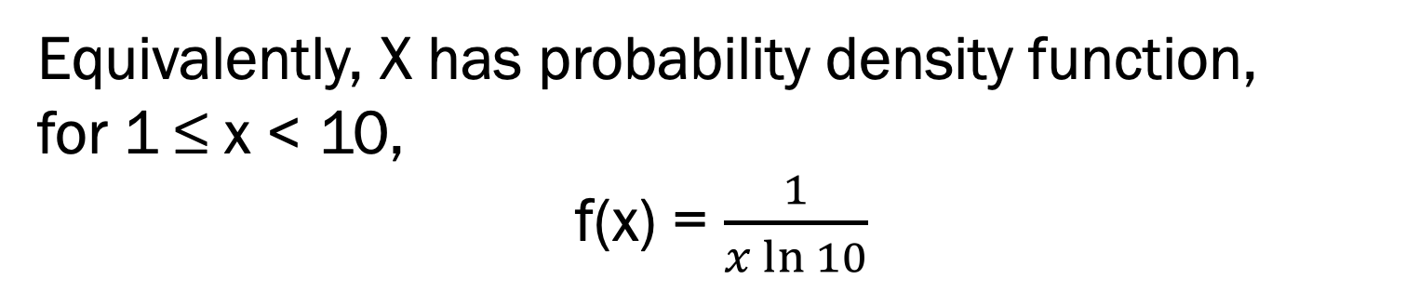
Continuous Models of Benford’s Law
Equivalently, X has probability density function,
for 1 ≤ x < 10,
f(x) = $\frac{1}{x\ln{10}}$
Note that with this density function:
P(X < s) = $\int_{1}^{s}{\frac{1}{x\ln{10}} dx}$
= $\frac{\ln{s}}{\ln{10}}$ = log s

Slide 83
Continuous Models of Benford’s Law
Equivalently, if U is a Uniform(0, 1) random variable, then X = 10^{U} has a Benford Distribution.
Proof: For 1 < s < 10
Since P(X < s) = P(10^{U} < s)
= P(U < log s)
= log s

Slide 84
Continuous Models of Benford’s Law
Equivalently, if U is a Uniform(0, 1) random variable, then X = 10^{U} has a Benford Distribution.
Thus to generate a Benford random variable, have your calculator generate a random number from (0, 1), then take 10 to that power. (DEMO)

Slide 85
Multiplication Game
In the Multiplication Game, I use my calculator to choose 10^{U}, then pick the first 4 digits of that answer.
If you multiply by number by 1 or 10 or 100 or 1000 (any power of 10), then I will win with probability log 4 = .602.

Slide 86
Fun Fact About Benford’s Law
If you multiply a Benford random variable by a constant k ≥ 1, it still has the Benford Property.

Slide 87
If X is Benford, then so is kX
Example: (k = 3; s = 7)
P(leading digit of 3X < 7)
= P(3X < 7 or 10 ≤ 3X < 70)
= P(X < 7/3) + P(X > 10/3)
= log (7/3) + 1 – log(10/3)
= log 7 – log 3 + 1 – log 10 + log 3
= log 7

Slide 88
If X is Benford, then so is kX
New Example: (k = 7; s = 3)
P(leading digit of 7X < 3)
= P(7X < 3 or 10 ≤ 7X < 30)
= P(X < 3/7) + P(X < 30/7) – P(X > 10/7)
= 0 + log(30/7) – log(10/7)
= log 3 + log(10/7) – log(10/7)
= log 3

Slide 89
Multiplication Game
In the Multiplication Game, I use my calculator to choose X = 10^{U}, then pick the first 4 digits of that answer.
Thus no matter what number you choose, say k ≥ 1,
P(leading digit of kX is 1 or 2 or 3)
= P(leading digit of kX < 4) = log 4 = 0.6

Slide 90
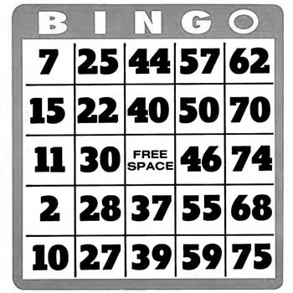

Slide 91
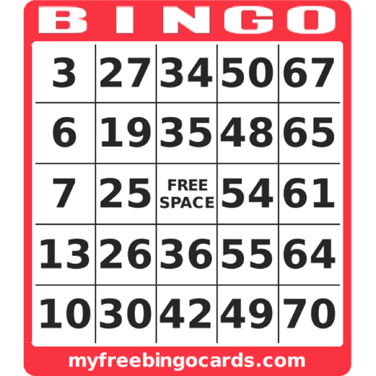

A Typical Bingo Card

Slide 92
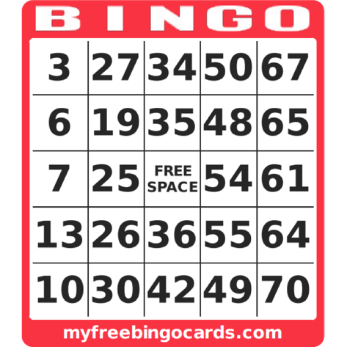
1-15
16-30
31-45
46-60
61-75

Slide 93
Question:
What is more likely to appear first on your card:
A Horizontal BINGO?
or
A Vertical BINGO?
Answer: Equally likely

Slide 94
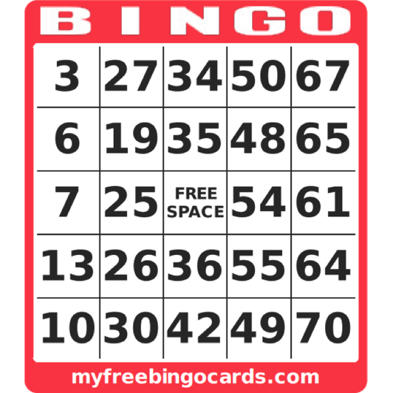

Slide 98
When playing with a single card, your Bingo can have one of 7 shapes:
H, V, D, HV, HD, VD, HVD

Slide 99
H: Horizontal Bingo

Slide 100
V: Vertical Bingo

Slide 101
D: Diagonal Bingo

Slide 102
HV: Horizontal and Vertical Bingo

Slide 103
HD: Horizontal and Diagonal

Slide 104
VD: Vertical and Diagonal

Slide 105
HVD: All 3 Bingos

Slide 106
Single Card Results
When playing with a single card, what are the chances that your Bingo ends up in each of these shapes?
H, V, D, HV, HD, VD, HVD

Slide 107
Results when N cards are used
N | H | V | D | HV | HD | VD | HVD
1*
1
1000
^ | ^^^ | does | not | use | the | free | space
1*
1
1000
*Exact Calculation

Slide 108
Results when N cards are used
N | H | V | D | HV | HD | VD | HVD
1* | 39.41 | 39.41 | 13.33 | 4.97 | 1.31 | 1.31 | 0.26
1
1000
^ | ^^^ | does | not | use | the | free | space
1*
1
1000
*Exact Calculation

Slide 109
Results when N cards are used
(100,000 trials)
N | H | V | D | HV | HD | VD | HVD
1* | 39.41 | 39.41 | 13.33 | 4.97 | 1.31 | 1.31 | 0.26
1 | 39.62 | 39.36 | 13.18 | 4.97 | 1.35 | 1.26 | 0.26
1000
^ | ^^^ | does | not | use | the | free | space
1*
1
1000
*Exact Calculation

Slide 110
New Question:
Suppose we play with 1000 BINGO cards. Is the winning card more likely to be:
A Horizontal BINGO?
or
A Vertical BINGO?
Answer: Horizontal (by a lot)

Slide 111
Results when N cards are used
(Single winner:100,000 trials)
N | H | V | D | HV | HD | VD | HVD
1* | 39.41 | 39.41 | 13.33 | 4.97 | 1.31 | 1.31 | 0.26
1 | 39.62 | 39.36 | 13.18 | 4.97 | 1.35 | 1.26 | 0.26
1000 | 54.2 | 24.5 | 21.3 | 0.01 | 0 | 0 | 0
^ | ^^^ | does | not | use | the | free | space
1*
1
1000

Slide 112
Results when N cards are used
(Single winner:100,000 trials)
N | H | V | D | HV | HD | VD | HVD
1* | 39.41 | 39.41 | 13.33 | 4.97 | 1.31 | 1.31 | 0.26
1 | 39.62 | 39.36 | 13.18 | 4.97 | 1.35 | 1.26 | 0.26
1000 | 54.2 | 24.5 | 21.3 | 0.01 | 0 | 0 | 0
^ | ^^^ | does | not | use | the | free | space
1*
1
1000
H wins more than twice as often as V.

Slide 113
Results when N cards are used
(Single winner:100,000 trials)
N | H | V | D | HV | HD | VD | HVD
1* | 39.41 | 39.41 | 13.33 | 4.97 | 1.31 | 1.31 | 0.26
1 | 39.62 | 39.36 | 13.18 | 4.97 | 1.35 | 1.26 | 0.26
1000 | 54.2 | 24.5 | 21.3 | 0.01 | 0 | 0 | 0
^ | ^^^ | does | not | use | the | free | space
1*
1
1000
 | ^^^ | does |  | use | the | free | space

Slide 114
Results when N cards are used
(Single winner:100,000 trials)
N | H | V | D | HV | HD | VD | HVD
1* | 39.41 | 39.41 | 13.33 | 4.97 | 1.31 | 1.31 | 0.26
1 | 39.62 | 39.36 | 13.18 | 4.97 | 1.35 | 1.26 | 0.26
1000 | 54.2 | 24.5 | 21.3 | 0.01 | 0 | 0 | 0
^ | ^^^ | does | not | use | the | free | space
1* | 35.87 | 35.87 | 20.62 | 4.13 | 1.62 | 1.62 | 0.28
1
1000
 | ^^^ | does |  | use | the | free | space
*Exact Calculation

Slide 115
Results when N cards are used
(Single winner:100,000 trials)
N | H | V | D | HV | HD | VD | HVD
1* | 39.41 | 39.41 | 13.33 | 4.97 | 1.31 | 1.31 | 0.26
1 | 39.62 | 39.36 | 13.18 | 4.97 | 1.35 | 1.26 | 0.26
1000 | 54.2 | 24.5 | 21.3 | 0.01 | 0 | 0 | 0
^ | ^^^ | does | not | use | the | free | space
1* | 35.87 | 35.87 | 20.62 | 4.13 | 1.62 | 1.62 | 0.28
1 | 36.29 | 35.54 | 20.43 | 4.26 | 1.64 | 1.55 | 0.29
1000
 | ^^^ | does |  | use | the | free | space

Slide 116
Results when N cards are used
(Single winner:100,000 trials)
N | H | V | D | HV | HD | VD | HVD
1* | 39.41 | 39.41 | 13.33 | 4.97 | 1.31 | 1.31 | 0.26
1 | 39.62 | 39.36 | 13.18 | 4.97 | 1.35 | 1.26 | 0.26
1000 | 54.2 | 24.5 | 21.3 | 0.01 | 0 | 0 | 0
^ | ^^^ | does | not | use | the | free | space
1* | 35.87 | 35.87 | 20.62 | 4.13 | 1.62 | 1.62 | 0.28
1 | 36.29 | 35.54 | 20.43 | 4.26 | 1.64 | 1.55 | 0.29
1000 |  | 21.8 |  | 0 | 0 | 0 | 0
 | ^^^ | does |  | use | the | free | space
V is still a big underdog

Slide 117
Results when N cards are used
(Single winner:100,000 trials)
N | H | V | D | HV | HD | VD | HVD
1* | 39.41 | 39.41 | 13.33 | 4.97 | 1.31 | 1.31 | 0.26
1 | 39.62 | 39.36 | 13.18 | 4.97 | 1.35 | 1.26 | 0.26
1000 | 54.2 | 24.5 | 21.3 | 0.01 | 0 | 0 | 0
^ | ^^^ | does | not | use | the | free | space
1* | 35.87 | 35.87 | 20.62 | 4.13 | 1.62 | 1.62 | 0.28
1 | 36.29 | 35.54 | 20.43 | 4.26 | 1.64 | 1.55 | 0.29
1000 | ??? | 21.8 | ??? | 0 | 0 | 0 | 0
 | ^^^ | does |  | use | the | free | space
more surprising results later…

Slide 118
This is the BINGO Paradox:
In the game of BINGO, when many cards are in use, it is much more likely for the winning card to be Horizontal instead of Vertical.
This result is true whether or not the cards have a Free Space.
Why?

Slide 119
Instead of Analyzing the game with 1000 cards…
Suppose we play with every possible card
How many?

Slide 120
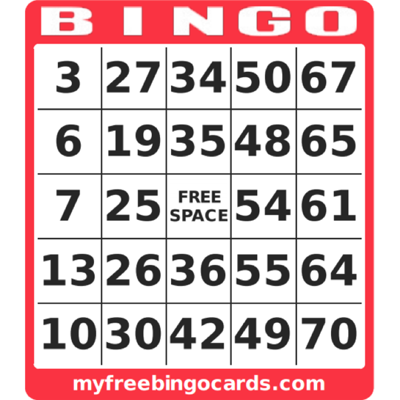
How many possibilities for Column B?
15 x 14 x 13 x 12 x 11
Same with Columns
I N* G O
(*ignoring the Free Space for now)
1-15
16-30
31-45
46-60
61-75

Slide 121
Instead of Analyzing the game with 1000 cards…
Suppose we play with every possible card
How many?
(15 x 14 x 13 x 12 x 11)⁵
≈ 6.08 x 10²⁷ cards
“Galactic Bingo!”

Slide 122
Suppose in Galactic Bingo, the first 7 numbers are...
B11
I23
G58
B13
Is it possible for any card to have 5 in a column or row?
No, because no letter has appeared 5 times, and the letter O has not appeared yet.
I21
N34
G55

Slide 123
But if the 8th number is O75
B11
I23
G58
B13
Then since every letter has appeared, there must be at least one card with a Horizontal win, but there are no cards with a Vertical win.
I21
N34
G55

Slide 124
Note: as soon as all 5 letters appear we will have Diagonal winners too.
In Galactic Bingo, Horizontal and Diagonal bingos always occur at the same time.

Slide 125
The Big Question
For a randomly generated sequence of BINGO numbers, what is the probability that
all 5 letters appear before any letter appears 5 times?
When this happens, there is a winning horizontal card; otherwise there is a winning vertical card.

Slide 126
If all 5 letters appear before
any letter appears 5 times, we call it a horizontal sequence. Otherwise, it’s a vertical sequence.
Example:
B11, I23, G58, B13, I21, N34, G55, O75,…
is a horizontal sequence.
We say it has property H8 since it becomes horizontal on the 8th draw

Slide 127
In general, a sequence has property Hn if it becomes horizontal (all 5 letter appear)
on the nth draw.
It has property Vn if it becomes vertical (a letter appears 5 times) on the nth draw.
Every sequence has property
Hn or Vn for some n.

Slide 128
Obviously, a BINGO sequence needs at least 5 draws before it can become Horizontal or Vertical.
Less obviously, a BINGO sequence is guaranteed to become Horizontal or Vertical within 17 draws.
(With 16 draws, you could have, say, 4Bs, 4Is, 4Ns, and 4Gs.)

Slide 129
No sequence is Horizontal and Vertical.
Why?
The winning number, say O75, can’t simultaneously be the first time O appears and the 5th time O appears.

Slide 130


The chance of winning in 5 draws.
The chance of a Horizontal win is:
The chance of a Vertical win is:
Horizontal is 50 times more likely!

Slide 131
After the 5th draw, the counting gets more complicated, but we can do it!

Slide 132
After computing P(Hn) and P(Vn)
for n = 5, 6, 7, …, 17,
by counting 70 shapes
(35 for Hn and 35 for Vn)*
we arrive at the following table.
*Not a coincidence

Slide 133
n | shapes | P(Hn) | P(Vn) | ratio | sum | cumulative
5 | 1 | 0.04400 | 0.00087 | 50.57 | 0.0449 | 0.0449
6 | 1 | 0.08800 | 0.00373 | 23.60 | 0.0917 | 0.1366
7 | 2 | 0.11350 | 0.00956 | 11.87 | 0.1231 | 0.2597
8 | 3 | 0.12052 | 0.01903 | 6.33 | 0.1396 | 0.3992
9 | 4 | 0.11220 | 0.02902 | 3.87 | 0.1412 | 0.5404
10 | 4 | 0.09415 | 0.03652 | 2.58 | 0.1307 | 0.6711
11 | 5 | 0.07191 | 0.03968 | 1.81 | 0.1116 | 0.7827
12 | 4 | 0.04972 | 0.03748 | 1.33 | 0.0872 | 0.8699
13 | 4 | 0.03075 | 0.03085 | 1.00 | 0.0616 | 0.9315
14 | 3 | 0.01658 | 0.02178 | 0.76 | 0.0384 | 0.9698
15 | 2 | 0.00742 | 0.01260 | 0.59 | 0.0200 | 0.9898
16 | 1 | 0.00254 | 0.00558 | 0.45 | 0.0081 | 0.9980
17 | 1 | 0.00052 | 0.00151 | 0.34 | 0.0020 | 1.0000
Sum | 35 | 0.752 | 0.248 | 3.03 | 1.0000

Slide 134
Overall: P(H) ≈ 0.752, P(V) ≈ 0.248

Slide 135
Still not convinced?
Let’s consider a really SMALL version of BINGO.
Suppose it was played on a
2-by-2 card.

Slide 136
B | O
1 | 3
2 | 4
Has only 4 possible draws:
B1, B2, O3, O4

Slide 137
B | O
1 | 3
2 | 4
Played with just 1 card, a horizontal win is just as likely as a vertical win.

Slide 138
There are only 4 possible cards:
B | O
1 | 3
2 | 4
B | O
1 | 4
2 | 3
B | O
2 | 3
1 | 4
B | O
2 | 4
1 | 3
Suppose the first draw is B1

Slide 139
In Galactic BO, there are only 4 possible cards:
B | O
1 | 3
2 | 4
B | O
1 | 4
2 | 3
B | O
2 | 3
1 | 4
B | O
2 | 4
1 | 3
Suppose the first draw is B1

Slide 140
B | O
1 | 3
2 | 4
B | O
1 | 4
2 | 3
B | O
2 | 3
1 | 4
B | O
2 | 4
1 | 3
Suppose the first draw is B1
If the next draw is B2, Vertical wins

Slide 141
B | O
1 | 3
2 | 4
B | O
1 | 4
2 | 3
B | O
2 | 3
1 | 4
B | O
2 | 4
1 | 3
Suppose the first draw is B1
If the next draw is B2, Vertical wins
If the next draw is O3, Horiz wins

Slide 142
Horizontal has 2-to-1 advantage!
B | O
1 | 3
2 | 4
B | O
1 | 4
2 | 3
B | O
2 | 3
1 | 4
B | O
2 | 4
1 | 3
Suppose the first draw is B1
If the next draw is B2, Vertical wins
If the next draw is O3, Horiz wins
If the next draw is O4, Horiz wins

Slide 143
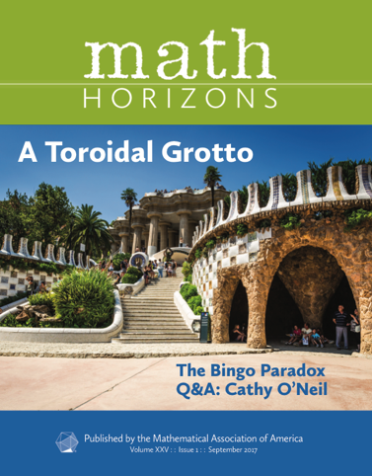
See September 2017 issue of Math Horizons

Slide 144
A mathematical method for predicting the score of a baseball game, before the game even starts.

Slide 145
A mathematical method for predicting the score of a baseball game before the game
even starts.
Always predict 0-0.

Slide 146
A mathematical method for predicting the score of a baseball game before the game even starts.
Always predict 0-0.

