Slide 1
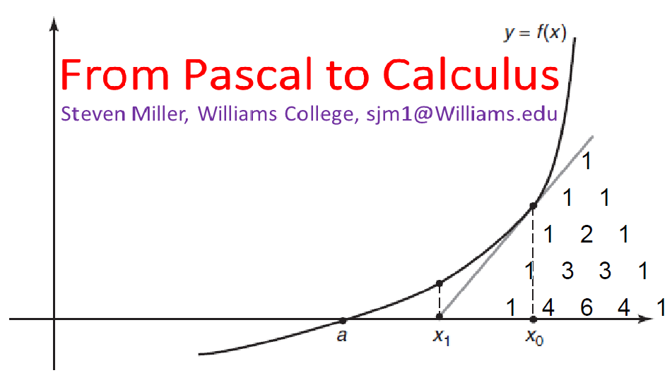

Slide 2
PART I:
Pascal’s Triangle

Slide 3
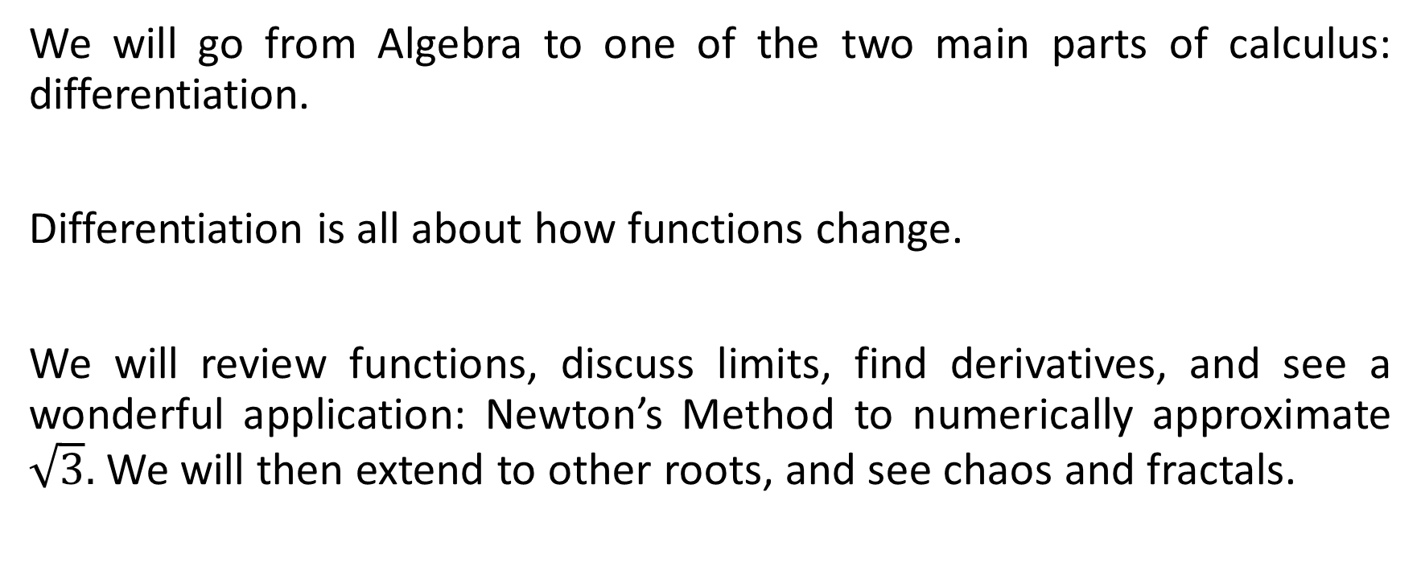
Goal of the Talk
We will go from Algebra to one of the two main parts of calculus: differentiation.
Differentiation is all about how functions change.
We will review functions, discuss limits, find derivatives, and see a wonderful application: Newton’s Method to numerically approximate $\sqrt{3}.$ We will then extend to other roots, and see chaos and fractals.

Slide 4
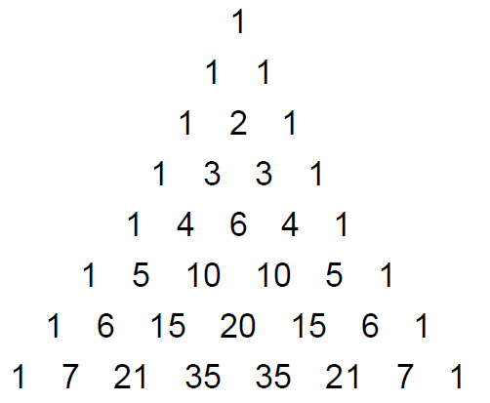
Pascal’s Triangle
The numbers in the n^{th} row of Pascal’s Triangle are the coefficients we obtain in expanding (x+y)^{n}.
Equivalently, we have two diagonals of 1, and all other elements are the sum of the elements in the row above immediately to the left and immediately to the right.

Slide 5
FOIL
FOIL stands for FIRST, OUTSIDE, INSIDE and LAST.
It provides a framework to multiply (a+b) and (c+d).
We have:
(a + b) * (c + d) = a * c + a * d + b * c + b * d.
FIRST OUTSIDE INSIDE LAST

Slide 6
FOIL
FOIL stands for FIRST, OUTSIDE, INSIDE and LAST.
It provides a framework to multiply (a+b) and (c+d).
We have:
(a + b) * (c + d) = a * c + a * d + b * c + b * d.
Thus:
(3 + 5) * (7-2) = 3 * 7 + 3 * (-2) + 5 * 7 + 5 * (-2) = 21 – 6 + 35 – 10 = 40 (which is 8 * 5).
(x + y) * (x – y) = x * x + x * (-y) + y * x + y * (-y) = x² – x y + y x – y² = x² – y².
(x + y) * (x + y) = x * x + x * y + y * x + y * y = x² + x y + y x + y² = x² + 2 x y + y².

Slide 7
FOIL
FOIL stands for FIRST, OUTSIDE, INSIDE and LAST.
We can repeatedly apply it, and its generalizations…..
We have:
(x + y)² = (x + y) * (x + y) = x * x + x * y + y * x + y * y = x² + x y + y x + y² = x² + 2 x y + y².
So:
(x + y)³ = (x + y) * (x + y)² = (x + y) * (x² + 2 x y + y²)
= x * (x² + 2 x y + y²) + y * (x² + 2 x y + y²)
= (x³ + 2 x² y + x y²) + (x² y + 2 x y² + y³)
= x³ + 3 x² y + 3 x y² + y³.

Slide 8
FOIL
FOIL stands for FIRST, OUTSIDE, INSIDE and LAST.
We can repeatedly apply it, and its generalizations…..
We have:
(x + y)² = (x + y) * (x + y) = x * x + x * y + y * x + y * y = x² + x y + y x + y² = 1 x² + 2 x y + 1 y².
So:
(x + y)³ = (x + y) * (x + y)² = (x + y) * (x² + 2 x y + y²)
= x * (x² + 2 x y + y²) + y * (x² + 2 x y + y²)
= (x³ + 2 x² y + x y²) + (x² y + 2 x y² + y³)
= 1 x³ + 3 x² y + 3 x y² + 1 y³.

Slide 9
Expanding (x + y)^{n}
(x + y)¹ = 1 x + 1 y
(x + y)² = 1 x² + 2 x y + 1 y².
(x + y)³ = 1 x³ + 3 x² y + 3 x y² + 1 y³.
This is the start of Pascal’s Triangle…..
How should we define (x + y)⁰? Well, we often say things to to zeroth power are 1, so we extend to….

Slide 10
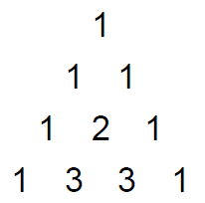
Expanding (x + y)^{n}
(x + y)⁰ = 1
(x + y)¹ = 1 x + 1 y
(x + y)² = 1 x² + 2 x y + 1 y².
(x + y)³ = 1 x³ + 3 x² y + 3 x y² + 1 y³.
This is the start of Pascal’s Triangle…..
We re-write it in triangular form….

Slide 11
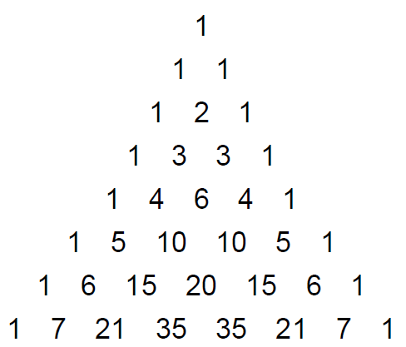
Expanding (x + y)^{n}
(x + y)⁰ = 1
(x + y)¹ = 1 x + 1 y
(x + y)² = 1 x² + 2 x y + 1 y².
(x + y)³ = 1 x³ + 3 x² y + 3 x y² + 1 y³.
We can keep going and get more and more rows…..

Slide 12
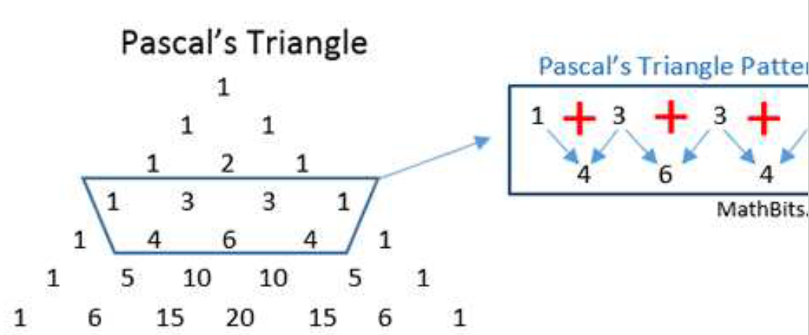

Why is the Pascal Relation true? Each number is the sum of what is immediately above to the right and to the left.

Slide 13
Sketch of the proof:
Assume we know one row, say
(x+y)⁵ = x⁵ + 5 x⁴ y + 10 x³ y² + 10 x² y³ + 5 x y⁴ + y⁵.
Then
(x+y)⁶ = (x+y) (x+y)⁵
= x (x+y)⁵ + y (x+y)⁵
= x (x⁵ + 5 x⁴ y + 10 x³ y² + 10 x² y³ + 5 x y⁴ + y⁵) + y (x⁵ + 5 x⁴ y + 10 x³ y² + 10 x² y³ + 5 x y⁴ + y⁵)
= (x⁶ + 5 x⁵ y + 10 x⁴ y² + 10 x³ y³ + 5 x² y⁴ + x y⁵) + (x⁵ y + 5 x⁴ y² + 10 x³ y³ + 10 x² y⁴ + 5 x y⁵ + y⁶)
= x⁶ + 5 x⁵ y + 10 x⁴ y² + 10 x³ y³ + 5 x² y⁴ + x y⁵
+ x⁵ y + 5 x⁴ y² + 10 x³ y³ + 10 x² y⁴ + 5 x y⁵ + y⁶
= x⁶ + (5+1) x⁵ y + (10+5) x⁴ y² + (10+10) x³ y³ + (5+10) x² y⁴ + (1+5) x y⁵ + y⁶
= x⁶ + 6 x⁵ y + 15 x⁴ y² + 20 x³ y³ + 15 x² y⁴ + 6 x y⁵ + y⁶

Slide 14
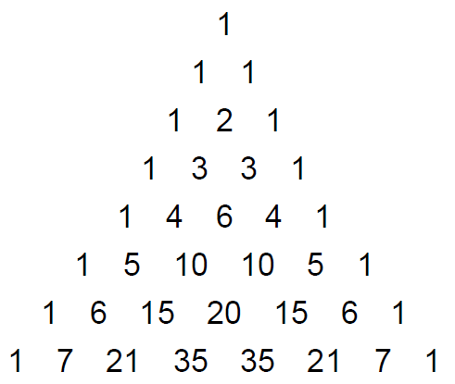
Pascal’s Triangle
While we can prove many properties of the coefficients of Pascal’s triangle, for small n we can just expand directly.

Slide 15
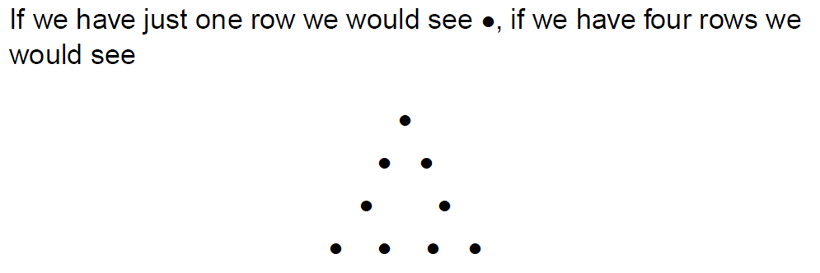
Pascal’s Triangle

Slide 16
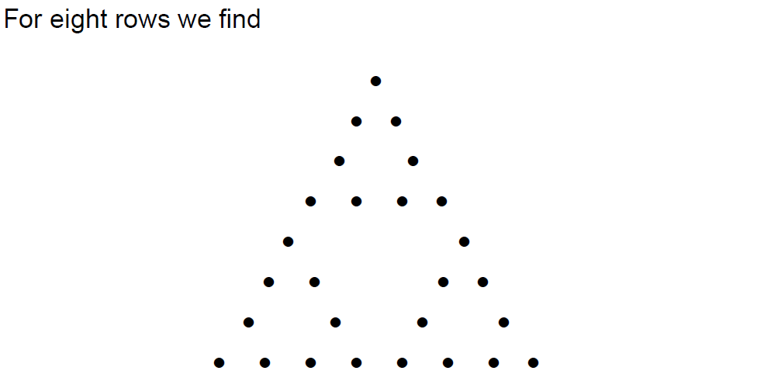
Pascal’s Triangle

Slide 17
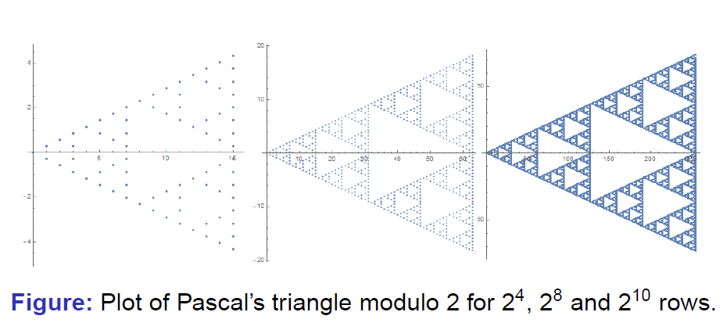
Pascal’s Triangle
https://www.youtube.com/watch?v=tt4_4YajqRM (start 1:35)

Slide 18
PART II:
Algebra and Limits

Slide 19
Evaluating Functions
A function takes an input and sends it to an output.
We often use the letter f to denote the function, and put the input in parentheses.
A linear function is of the form f(x) = a x + b for fixed constants a and b.
For example: f(x) = 3x – 5 or f(x) = 7x + 2 or f(x) = 4x + 17.

Slide 20
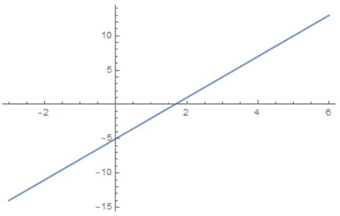
Evaluating Functions
For example: f(x) = 3x – 5. Let’s evaluate it at a few choices of x.
We have:
f(0) = 3 * 0 – 5 = -5
f(1) = 3 * 1 – 5 = -2
f(2) = 3 * 2 – 5 = 1
f(3) = 3 * 3 – 5 = 4
f(4) = 3 * 4 – 5 = 7

Slide 21
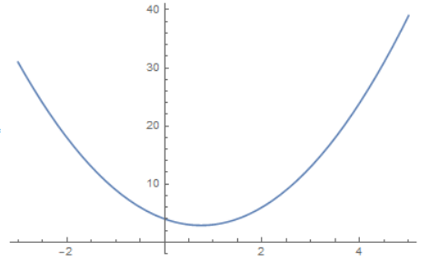
Quadratic Functions
Quadratic functions of the form f(x) = ax² + bx + c for constants a, b, c.
Consider f(x) = 2 x² – 3 x + 4.
We have:
f(0) = 2 * 0² – 3 * 0 + 4 = 4
f(1) = 2 * 1² – 3 * 1 + 4 = 3
f(2) = 2 * 2² – 3 * 2 + 4 = 6
f(3) = 2 * 3² – 3 * 3 + 4 = 13
f(4) = 2 * 4² – 3 * 4 + 4 = 24

Slide 22
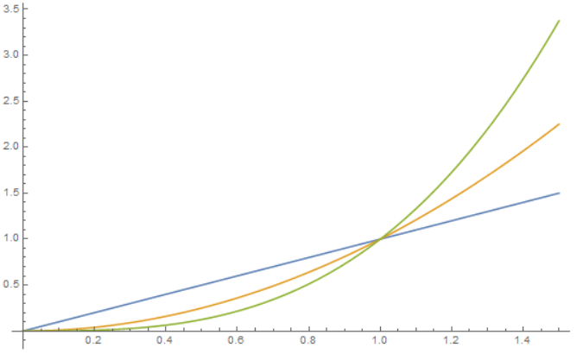
Polynomials
More generally can look at a polynomial of degree n: have constants a_{n,} a_{n-1,} …, a₁, a₀ so that f(x) = a_{n} x^{n} + a_{n-1} x^{n-1} + + a₁ x + a₀.
Here is a plot of
f(x) = x (linear)
g(x) = x² (quadratic)
h(x) = x³ (cubic)
for x between 0 and 1.5.

Slide 23
Limits
One of the most important concepts in calculus is that of a limit.
We want to know what happens to the output of a function as the inputs approach a specific value.
For polynomials the limit is easy. If f(x) = 3 x + 5, what is the limit of f(x) as x approaches 2? It would just be lim_{x → 2} f(x) =

Slide 24
Limits
One of the most important concepts in calculus is that of a limit.
We want to know what happens to the output of a function as the inputs approach a specific value.
For polynomials the limit is easy. If f(x) = 3 x + 5, what is the limit of f(x) as x approaches 2? It would just be lim_{x → 2} f(x) = f(2) = 3 * 2 + 5 = 11.

Slide 25
Limits
One of the most important concepts in calculus is that of a limit.
We want to know what happens to the output of a function as the inputs approach a specific value.
For polynomials the limit is easy. If f(x) = 3 x + 5, what is the limit of f(x) as x approaches 2? It would just be lim_{x → 2} f(x) = f(2) = 3 * 2 + 5.
Another way of writing x approaches 2 is to write x as 2 + h, and take the limit as h goes to 0.
This would be
lim_{x → 2} f(x) = lim_{h → 0} f(2+h) = lim_{h → 0} ???

Slide 26
Limits
One of the most important concepts in calculus is that of a limit.
We want to know what happens to the output of a function as the inputs approach a specific value.
For polynomials the limit is easy. If f(x) = 3 x + 5, what is the limit of f(x) as x approaches 2? It would just be lim_{x → 2} f(x) = f(2) = 3 * 2 + 5.
Another way of writing x approaches 2 is to write x as 2 + h, and take the limit as h goes to 0.
This would be
lim_{x → 2} f(x) = lim_{h → 0} f(2+h) = lim_{h → 0} (3 * (2+h) + 5) = lim_{h → 0} (6 + 3 h + 5).
Now the limit of the sum is the sum of the limits, and we have
lim_{h → 0} (6 + 3 h + 5) = lim_{h → 0} 6 + lim_{h → 0} 3 h + lim_{h → 0} 5 =

Slide 27
Limits
One of the most important concepts in calculus is that of a limit.
We want to know what happens to the output of a function as the inputs approach a specific value.
For polynomials the limit is easy. If f(x) = 3 x + 5, what is the limit of f(x) as x approaches 2? It would just be lim_{x → 2} f(x) = f(2) = 3 * 2 + 5.
Another way of writing x approaches 2 is to write x as 2 + h, and take the limit as h goes to 0.
This would be
lim_{x → 2} f(x) = lim_{h → 0} f(2+h) = lim_{h → 0} (3 * (2+h) + 5) = lim_{h → 0} (6 + 3 h + 5).
Now the limit of the sum is the sum of the limits, and we have
lim_{h → 0} (6 + 3 h + 5) = lim_{h → 0} 6 + lim_{h → 0} 3 h + lim_{h → 0} 5 = 6 + 0 + 5 = 11.

Slide 28
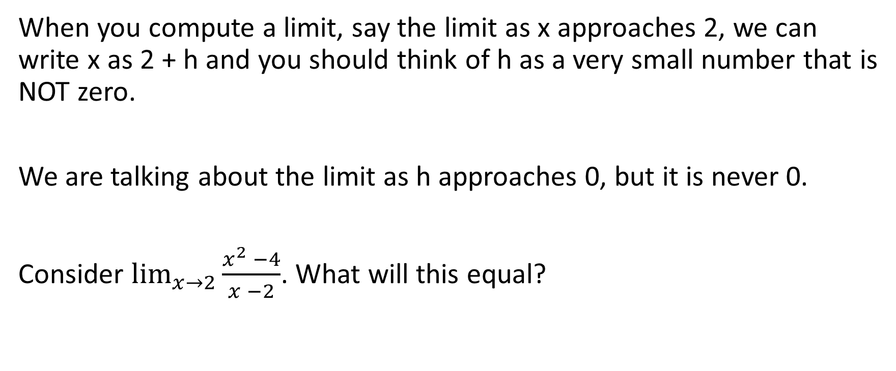
More on Limits
When you compute a limit, say the limit as x approaches 2, we can write x as 2 + h and you should think of h as a very small number that is NOT zero.
We are talking about the limit as h approaches 0, but it is never 0.
Consider $\lim_{x→2}{\frac{x^{2} −4}{x −2}}$. What will this equal?

Slide 29
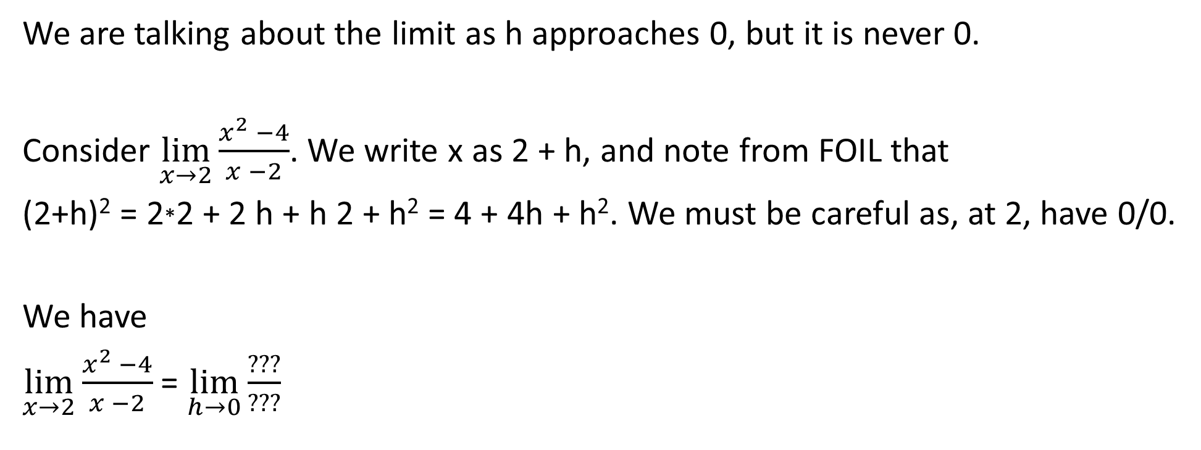
More on Limits
We are talking about the limit as h approaches 0, but it is never 0.
Consider $\lim_{x→2}{\frac{x^{2} −4}{x −2}}$. We write x as 2 + h, and note from FOIL that
(2+h)² = 2*2 + 2 h + h 2 + h² = 4 + 4h + h². We must be careful as, at 2, have 0/0.
We have
$\lim_{x→2}{\frac{x^{2} −4}{x −2}}$ = $\lim_{h→0}{\frac{???}{???}}$

Slide 30
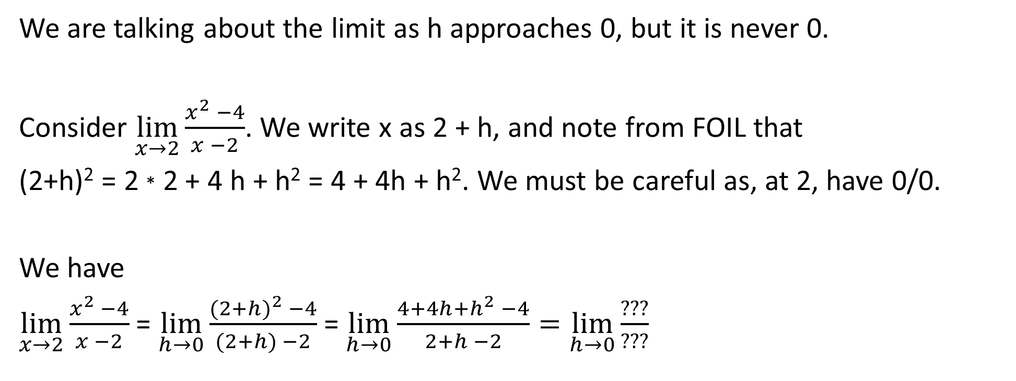
More on Limits
We are talking about the limit as h approaches 0, but it is never 0.
Consider $\lim_{x→2}{\frac{x^{2} −4}{x −2}}$. We write x as 2 + h, and note from FOIL that
(2+h)² = 2 * 2 + 4 h + h² = 4 + 4h + h². We must be careful as, at 2, have 0/0.
We have
$\lim_{x→2}{\frac{x^{2} −4}{x −2}}$ = $\lim_{h→0}{\frac{{(2+h)}^{2} −4}{(2+h) −2}}$ = $\lim_{h→0}{\frac{{4+4h+h}^{2} −4}{2+h −2}=\lim_{h→0}{\frac{???}{???}}}$

Slide 31
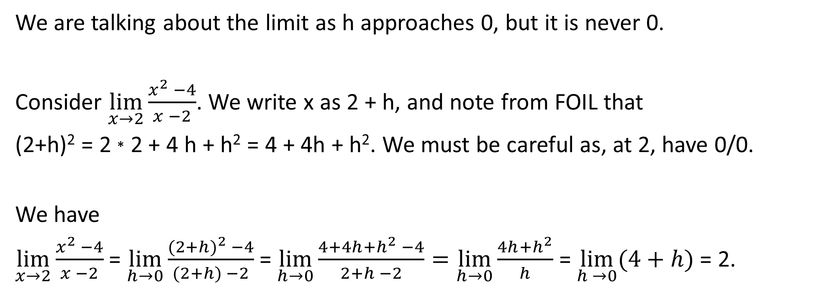
More on Limits
We are talking about the limit as h approaches 0, but it is never 0.
Consider $\lim_{x→2}{\frac{x^{2} −4}{x −2}}$. We write x as 2 + h, and note from FOIL that
(2+h)² = 2 * 2 + 4 h + h² = 4 + 4h + h². We must be careful as, at 2, have 0/0.
We have
$\lim_{x→2}{\frac{x^{2} −4}{x −2}}$ = $\lim_{h→0}{\frac{{(2+h)}^{2} −4}{(2+h) −2}}$ = $\lim_{h→0}{\frac{{4+4h+h}^{2} −4}{2+h −2}=\lim_{h→0}{\frac{{4h+h}^{2}}{h}}}$ = $\lim_{h →0}{(4+h)}$ = 2.

Slide 32
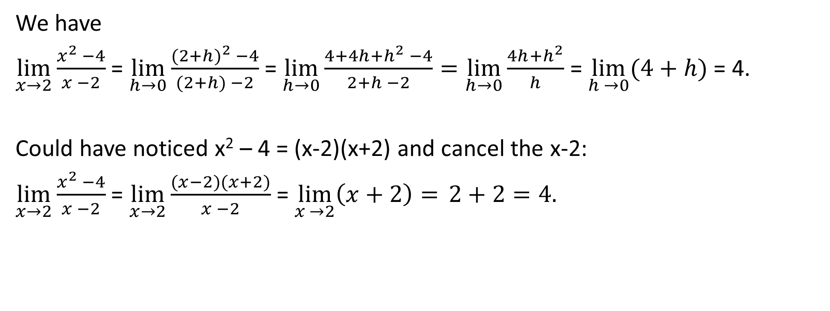
More on Limits
We have
$\lim_{x→2}{\frac{x^{2} −4}{x −2}}$ = $\lim_{h→0}{\frac{{(2+h)}^{2} −4}{(2+h) −2}}$ = $\lim_{h→0}{\frac{{4+4h+h}^{2} −4}{2+h −2}=\lim_{h→0}{\frac{{4h+h}^{2}}{h}}}$ = $\lim_{h →0}{(4+h)}$ = 4.
Could have noticed x² – 4 = (x-2)(x+2) and cancel the x-2:
$\lim_{x→2}{\frac{x^{2} −4}{x −2}}$ = $\lim_{x→2}{\frac{(x−2)(x+2)}{x −2}}$ = $\lim_{x →2}\left(x+2\right)= 2+2{=4.}$

Slide 33
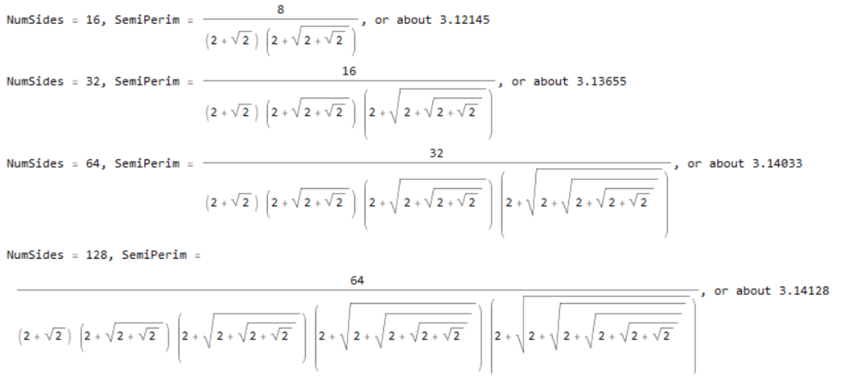
Not all limits are easy to compute. In an earlier lecture came up with some formulas for π….

Slide 34
PART III:
Introduction to Calculus: Differentiation

Slide 35
Average Speed
It is often a good idea to add units to a problem and tell a story. For example, if y = f(x), maybe x represents time and f(x) distance.
Thus we might be plotting how far we are from home on a trip.
Let f(0) = 0 (we start at home) and end the trip at x=2, with f(2) = 110. What was our average speed? What was our fastest speed? Our slowest speed? Our most common speed?
Which of these questions can you answer?

Slide 36
Average Speed
It is often a good idea to add units to a problem and tell a story. For example, if y = f(x), maybe x represents time and f(x) distance.
Thus we might be plotting how far we are from home on a trip.
Let f(0) = 0 (we start at home) and end the trip at x=2, with f(2) = 110. What was our average speed? What was our fastest speed? Our slowest speed? Our most common speed?
Which of these questions can you answer? Just the first: it is

Slide 37
Average Speed
It is often a good idea to add units to a problem and tell a story. For example, if y = f(x), maybe x represents time and f(x) distance.
Thus we might be plotting how far we are from home on a trip.
Let f(0) = 0 (we start at home) and end the trip at x=2, with f(2) = 110. What was our average speed? What was our fastest speed? Our slowest speed? Our most common speed?
Which of these questions can you answer? Just the first: it is 110/2 = 55 (we should have units – maybe time is in hours and distance in miles, so 55 mph).

Slide 38
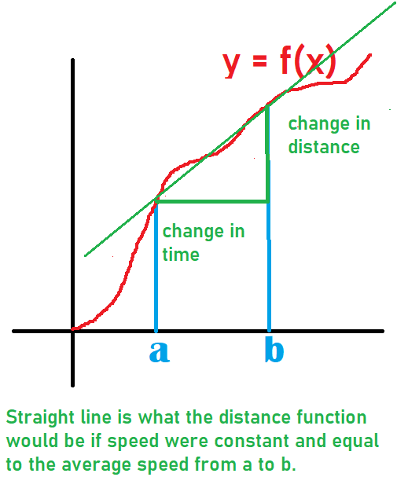
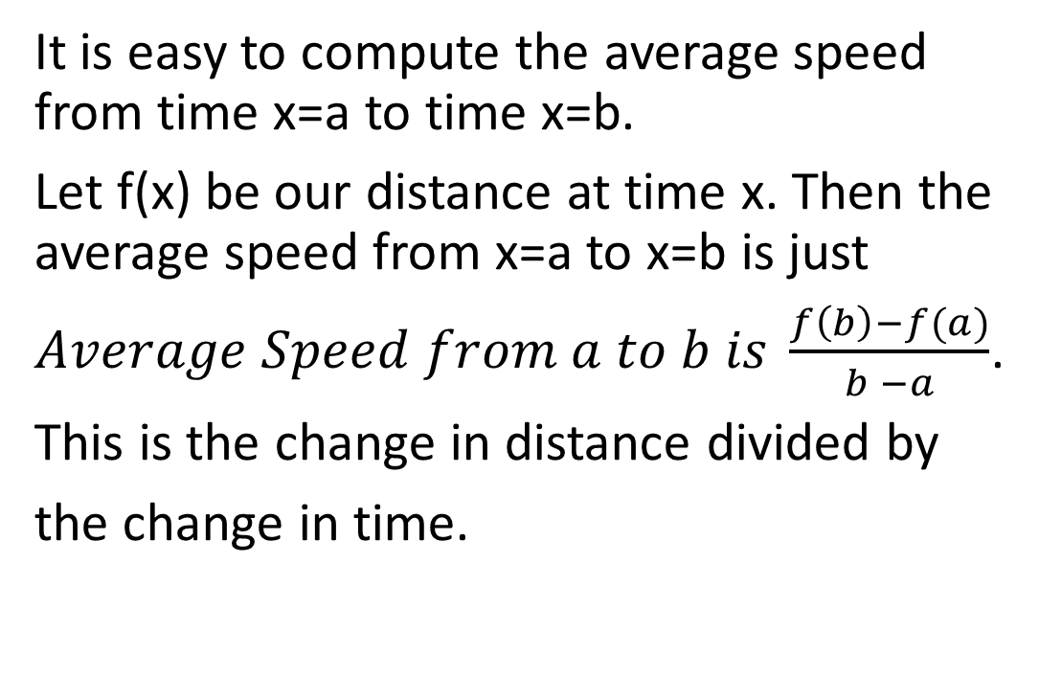
Computing Average Speed
It is easy to compute the average speed from time x=a to time x=b.
Let f(x) be our distance at time x. Then the average speed from x=a to x=b is just
$Average Speed from a to b is \frac{f\left(b\right)−f(a)}{b −a}$.
This is the change in distance divided by
the change in time.

Slide 39
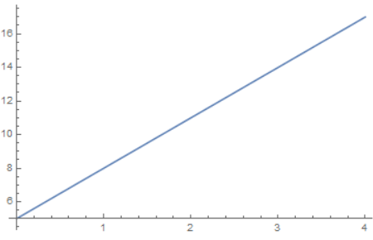
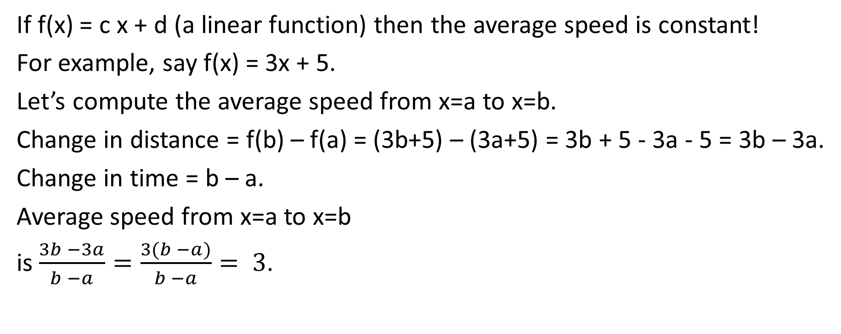
Average Speed for a Linear Function
If f(x) = c x + d (a linear function) then the average speed is constant!
For example, say f(x) = 3x + 5.
Let’s compute the average speed from x=a to x=b.
Change in distance = f(b) – f(a) = (3b+5) – (3a+5) = 3b + 5 - 3a - 5 = 3b – 3a.
Change in time = b – a.
Average speed from x=a to x=b
is $\frac{3b −3a}{b −a}=\frac{3(b −a)}{b −a}= 3$.

Slide 40
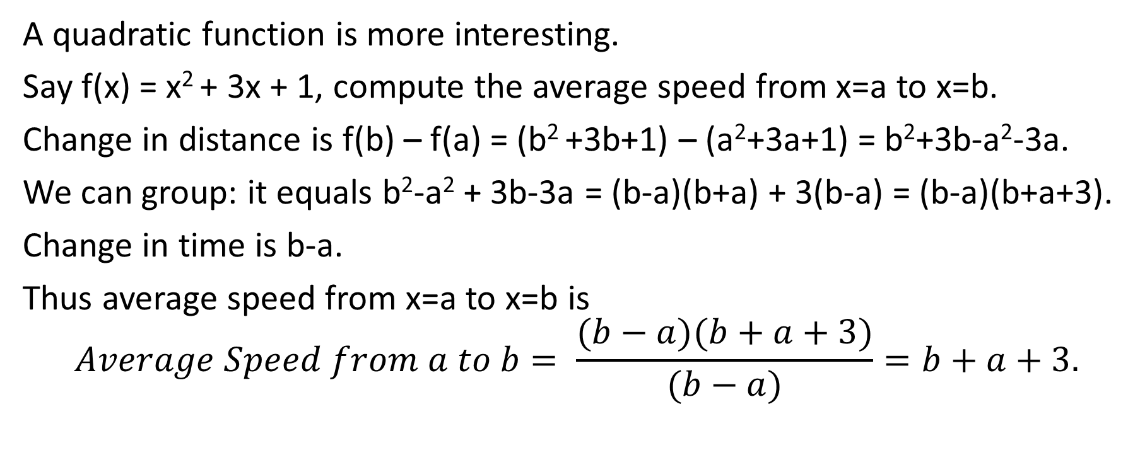
Average Speed for a Quadratic Function
A quadratic function is more interesting.
Say f(x) = x² + 3x + 1, compute the average speed from x=a to x=b.
Change in distance is f(b) – f(a) = (b² +3b+1) – (a²+3a+1) = b²+3b-a²-3a.
We can group: it equals b²-a² + 3b-3a = (b-a)(b+a) + 3(b-a) = (b-a)(b+a+3).
Change in time is b-a.
Thus average speed from x=a to x=b is
$$Average Speed from a to b= \frac{(b−a)(b+a+3)}{(b−a)}=b+a+3.$$

Slide 41
Average Speed for a Quadratic Function
A quadratic function is more interesting.
Say f(x) = x² + 3x + 1, compute the average speed from x=a to x=b.
Change in distance is f(b) – f(a) =

Slide 42
Average Speed for a Quadratic Function
A quadratic function is more interesting.
Say f(x) = x² + 3x + 1, compute the average speed from x=a to x=b.
Change in distance is f(b) – f(a) = (b² +3b+1) – (a²+3a+1) = b²+3b-a²-3a.
We can group: it equals

Slide 43
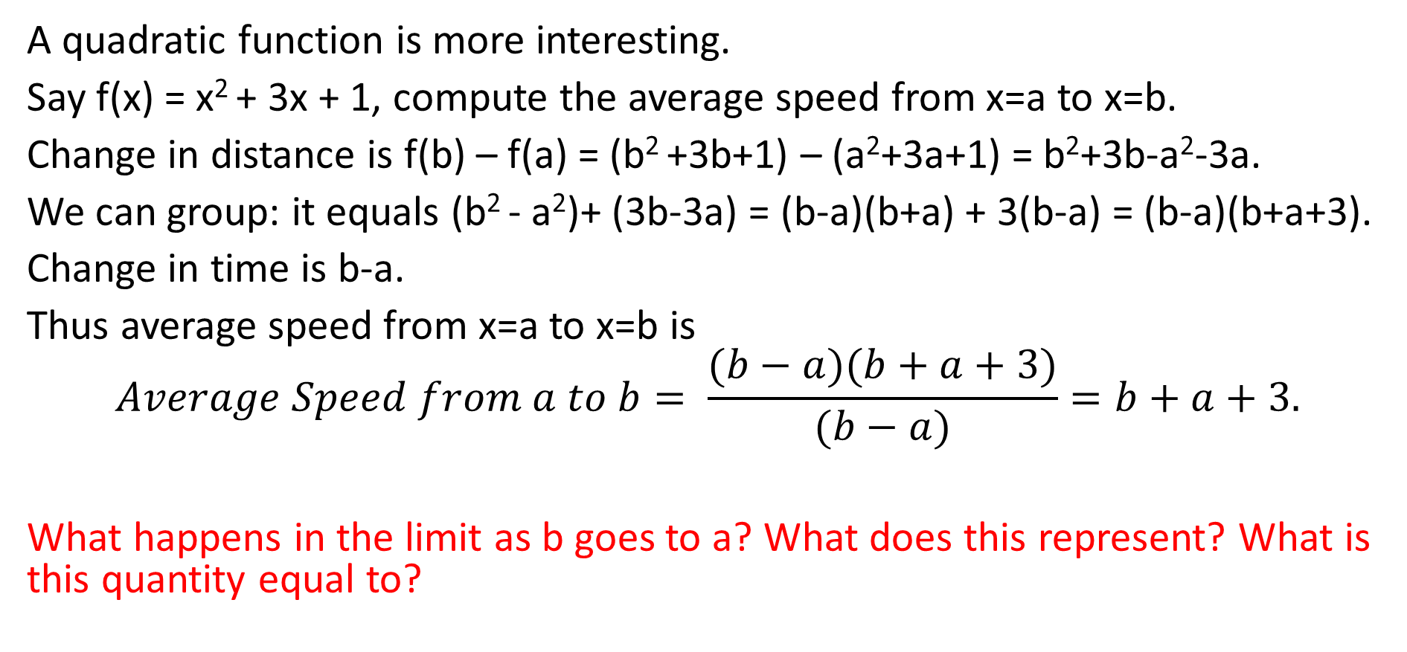
Average Speed for a Quadratic Function
A quadratic function is more interesting.
Say f(x) = x² + 3x + 1, compute the average speed from x=a to x=b.
Change in distance is f(b) – f(a) = (b² +3b+1) – (a²+3a+1) = b²+3b-a²-3a.
We can group: it equals (b² - a²)+ (3b-3a) = (b-a)(b+a) + 3(b-a) = (b-a)(b+a+3).
Change in time is b-a.
Thus average speed from x=a to x=b is
$$Average Speed from a to b= \frac{(b−a)(b+a+3)}{(b−a)}=b+a+3.$$
What happens in the limit as b goes to a? What does this represent? What is this quantity equal to?

Slide 44
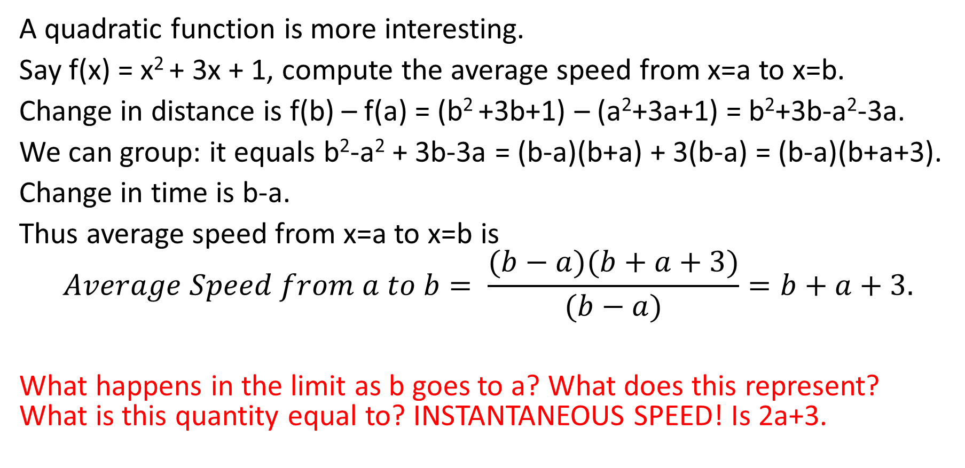
Average Speed for a Quadratic Function
A quadratic function is more interesting.
Say f(x) = x² + 3x + 1, compute the average speed from x=a to x=b.
Change in distance is f(b) – f(a) = (b² +3b+1) – (a²+3a+1) = b²+3b-a²-3a.
We can group: it equals b²-a² + 3b-3a = (b-a)(b+a) + 3(b-a) = (b-a)(b+a+3).
Change in time is b-a.
Thus average speed from x=a to x=b is
$$Average Speed from a to b= \frac{(b−a)(b+a+3)}{(b−a)}=b+a+3.$$
What happens in the limit as b goes to a? What does this represent? What is this quantity equal to? INSTANTANEOUS SPEED! Is 2a+3.

Slide 45
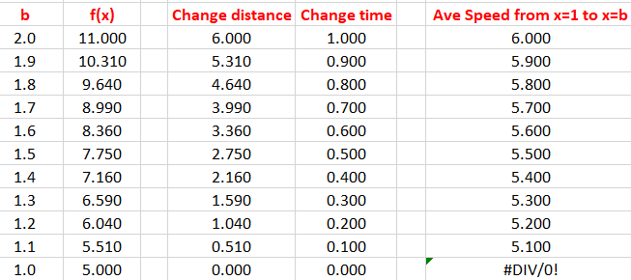
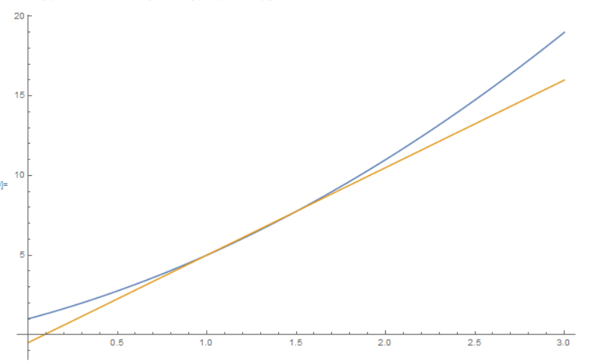
Calculating Average Speeds for f(x) = x²+3x+1
We calculate the average speeds for f(x) from x=1 to x=b.
When we take b=1 the average speed calculation blows up. The plot on the right is with b = 1.5. Notice how the average speeds seem to converge to a number….

Slide 46
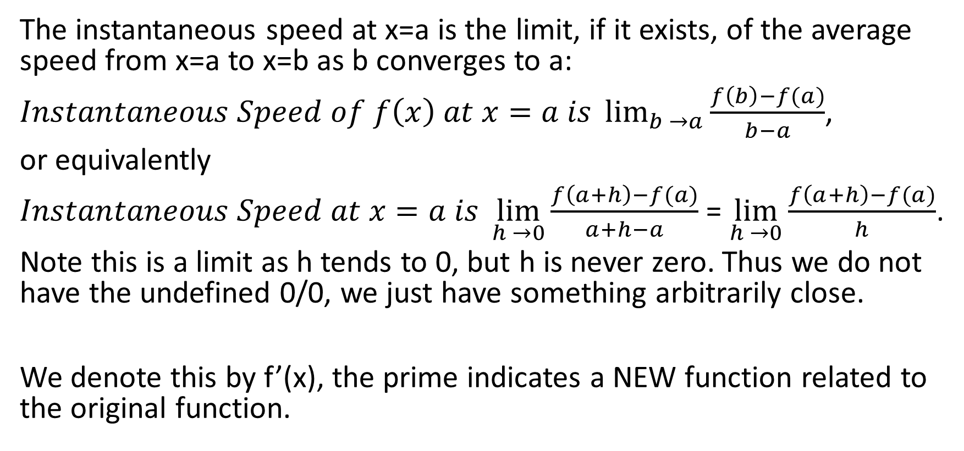
Instantaneous Speed
The instantaneous speed at x=a is the limit, if it exists, of the average speed from x=a to x=b as b converges to a:
$Instantaneous Speed of f\left(x\right) at x=a is \lim_{b →a}{\frac{f\left(b\right)−f(a)}{b−a}}$,
or equivalently
$Instantaneous Speed at x=a is \lim_{h →0}{\frac{f\left(a+h\right)−f(a)}{a+h−a}}$ = $\lim_{h →0}{\frac{f\left(a+h\right)−f(a)}{h}}$.
Note this is a limit as h tends to 0, but h is never zero. Thus we do not have the undefined 0/0, we just have something arbitrarily close.
We denote this by f’(x), the prime indicates a NEW function related to the original function.

Slide 47

Instantaneous Speed for Linear Functions
Let’s take f(x) = 3x + 5 and calculate the instantaneous speed at x=a.
$$f^{′}(a)= \lim_{h →0}{\frac{f\left(a+h\right)−f(a)}{h}}$$
So $f^{′}(a)= \lim_{h →0}{\frac{(3\left(a+h\right)+5)−(3a+5)}{h}}$ =

Slide 48

Instantaneous Speed for Linear Functions
Let’s take f(x) = 3x + 5 and calculate the instantaneous speed at x=a.
$$f^{′}(a)= \lim_{h →0}{\frac{f\left(a+h\right)−f(a)}{h}}$$
So $f^{′}(a)= \lim_{h →0}{\frac{(3\left(a+h\right)+5)−(3a+5)}{h}}$ = $\lim_{h →0}{\frac{(3a+3h+5)−(3a+5)}{h}}$ =

Slide 49
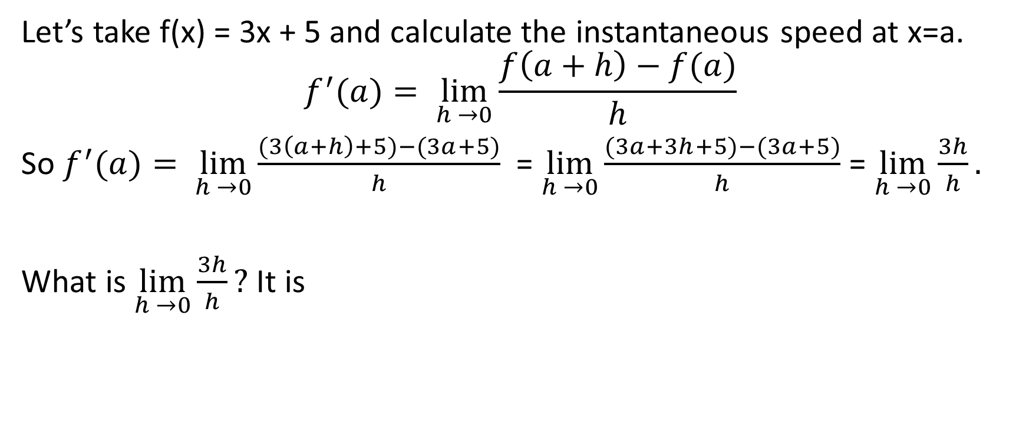
Instantaneous Speed for Linear Functions
Let’s take f(x) = 3x + 5 and calculate the instantaneous speed at x=a.
$$f^{′}(a)= \lim_{h →0}{\frac{f\left(a+h\right)−f(a)}{h}}$$
So $f^{′}(a)= \lim_{h →0}{\frac{(3\left(a+h\right)+5)−(3a+5)}{h}}$ = $\lim_{h →0}{\frac{(3a+3h+5)−(3a+5)}{h}}$ = $\lim_{h →0}{\frac{3h}{h}.}$
What is $\lim_{h →0}{\frac{3h}{h}? }$It is

Slide 50
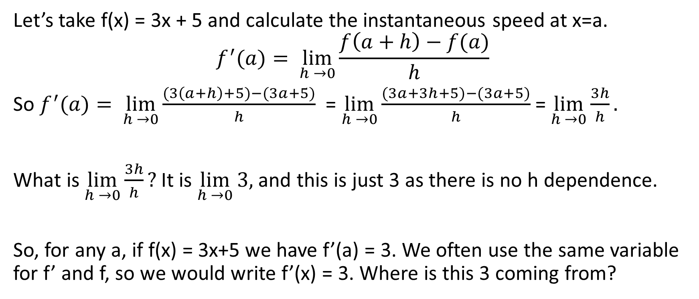
Instantaneous Speed for Linear Functions
Let’s take f(x) = 3x + 5 and calculate the instantaneous speed at x=a.
$$f^{′}(a)= \lim_{h →0}{\frac{f\left(a+h\right)−f(a)}{h}}$$
So $f^{′}(a)= \lim_{h →0}{\frac{(3\left(a+h\right)+5)−(3a+5)}{h}}$ = $\lim_{h →0}{\frac{(3a+3h+5)−(3a+5)}{h}}$ = $\lim_{h →0}{\frac{3h}{h}.}$
What is $\lim_{h →0}{\frac{3h}{h}? }$It is $\lim_{h →0}{3,}$ and this is just 3 as there is no h dependence.
So, for any a, if f(x) = 3x+5 we have f’(a) = 3. We often use the same variable for f’ and f, so we would write f’(x) = 3. Where is this 3 coming from?

Slide 51
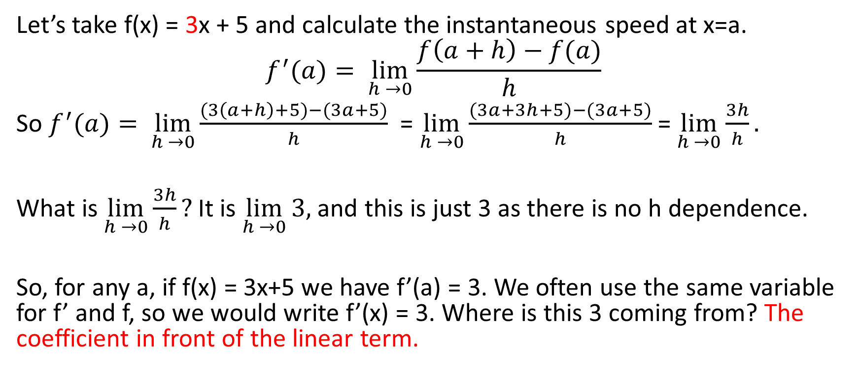
Instantaneous Speed for Linear Functions
Let’s take f(x) = 3x + 5 and calculate the instantaneous speed at x=a.
$$f^{′}(a)= \lim_{h →0}{\frac{f\left(a+h\right)−f(a)}{h}}$$
So $f^{′}(a)= \lim_{h →0}{\frac{(3\left(a+h\right)+5)−(3a+5)}{h}}$ = $\lim_{h →0}{\frac{(3a+3h+5)−(3a+5)}{h}}$ = $\lim_{h →0}{\frac{3h}{h}.}$
What is $\lim_{h →0}{\frac{3h}{h}? }$It is $\lim_{h →0}{3,}$ and this is just 3 as there is no h dependence.
So, for any a, if f(x) = 3x+5 we have f’(a) = 3. We often use the same variable for f’ and f, so we would write f’(x) = 3. Where is this 3 coming from? The coefficient in front of the linear term.

Slide 52
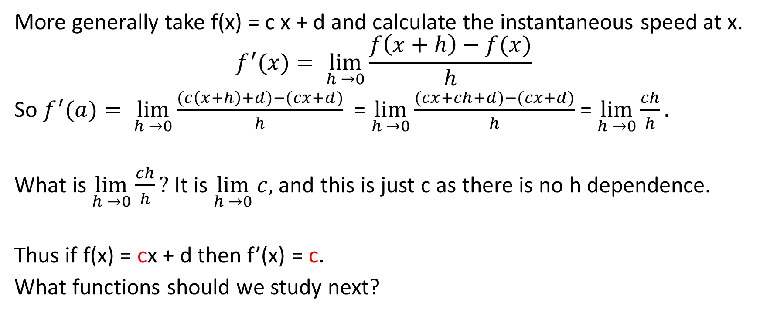
Instantaneous Speed for Linear Functions
More generally take f(x) = c x + d and calculate the instantaneous speed at x.
$$f^{′}(x)= \lim_{h →0}{\frac{f\left(x+h\right)−f(x)}{h}}$$
So $f^{′}(a)= \lim_{h →0}{\frac{(c\left(x+h\right)+d)−(cx+d)}{h}}$ = $\lim_{h →0}{\frac{(cx+ch+d)−(cx+d)}{h}}$ = $\lim_{h →0}{\frac{ch}{h}.}$
What is $\lim_{h →0}{\frac{ch}{h}? }$It is $\lim_{h →0}{c,}$ and this is just c as there is no h dependence.
Thus if f(x) = cx + d then f’(x) = c.
What functions should we study next?

Slide 53
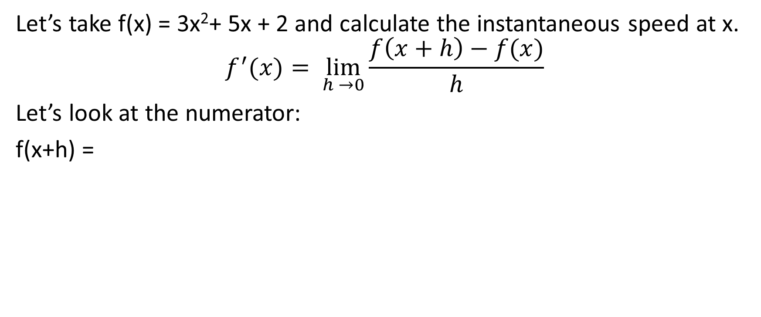
Instantaneous Speed for Quadratic Functions
Let’s take f(x) = 3x²+ 5x + 2 and calculate the instantaneous speed at x.
$$f^{′}(x)= \lim_{h →0}{\frac{f\left(x+h\right)−f(x)}{h}}$$
Let’s look at the numerator:
f(x+h) =

Slide 54
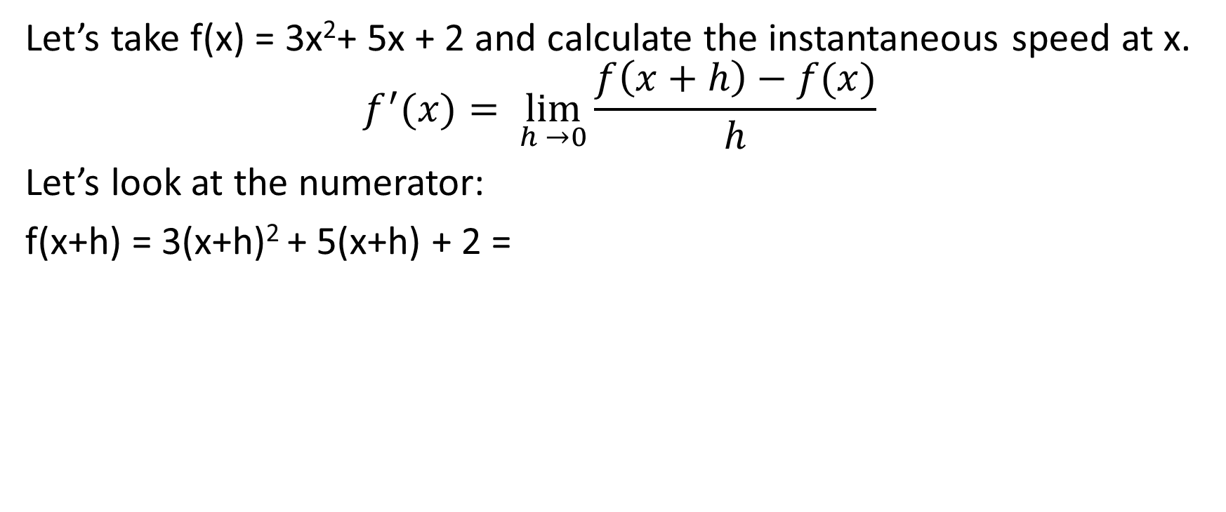
Instantaneous Speed for Quadratic Functions
Let’s take f(x) = 3x²+ 5x + 2 and calculate the instantaneous speed at x.
$$f^{′}(x)= \lim_{h →0}{\frac{f\left(x+h\right)−f(x)}{h}}$$
Let’s look at the numerator:
f(x+h) = 3(x+h)² + 5(x+h) + 2 =

Slide 55
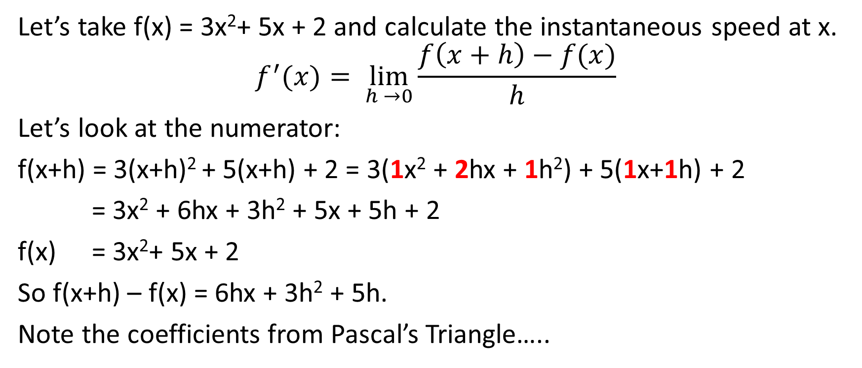
Instantaneous Speed for Quadratic Functions
Let’s take f(x) = 3x²+ 5x + 2 and calculate the instantaneous speed at x.
$$f^{′}(x)= \lim_{h →0}{\frac{f\left(x+h\right)−f(x)}{h}}$$
Let’s look at the numerator:
f(x+h) = 3(x+h)² + 5(x+h) + 2 = 3(1x² + 2hx + 1h²) + 5(1x+1h) + 2
= 3x² + 6hx + 3h² + 5x + 5h + 2
f(x) = 3x²+ 5x + 2
So f(x+h) – f(x) = 6hx + 3h² + 5h.
Note the coefficients from Pascal’s Triangle…..

Slide 56
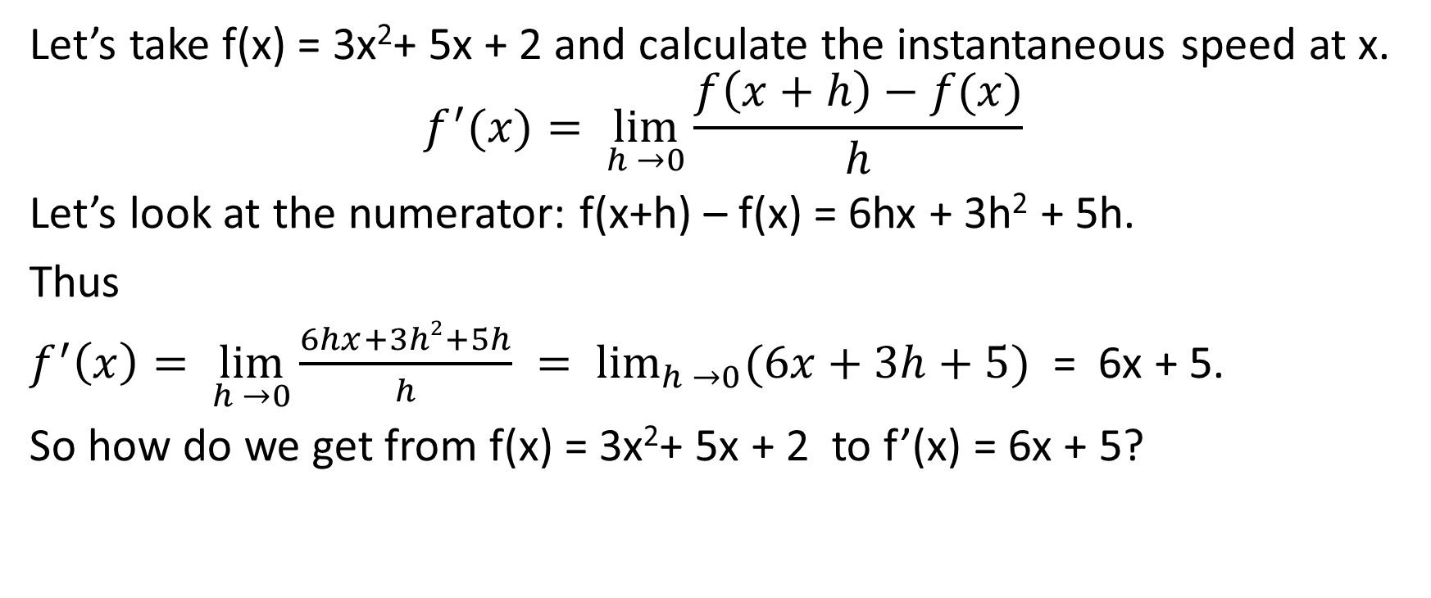
Instantaneous Speed for Quadratic Functions
Let’s take f(x) = 3x²+ 5x + 2 and calculate the instantaneous speed at x.
$$f^{′}(x)= \lim_{h →0}{\frac{f\left(x+h\right)−f(x)}{h}}$$
Let’s look at the numerator: f(x+h) – f(x) = 6hx + 3h² + 5h.
Thus
$f^{′}\left(x\right)= \lim_{h →0}{\frac{6hx+3h2+5h}{h}} = \lim_{h →0}{(6x+3h+5)}$ = 6x + 5.
So how do we get from f(x) = 3x²+ 5x + 2 to f’(x) = 6x + 5?

Slide 57
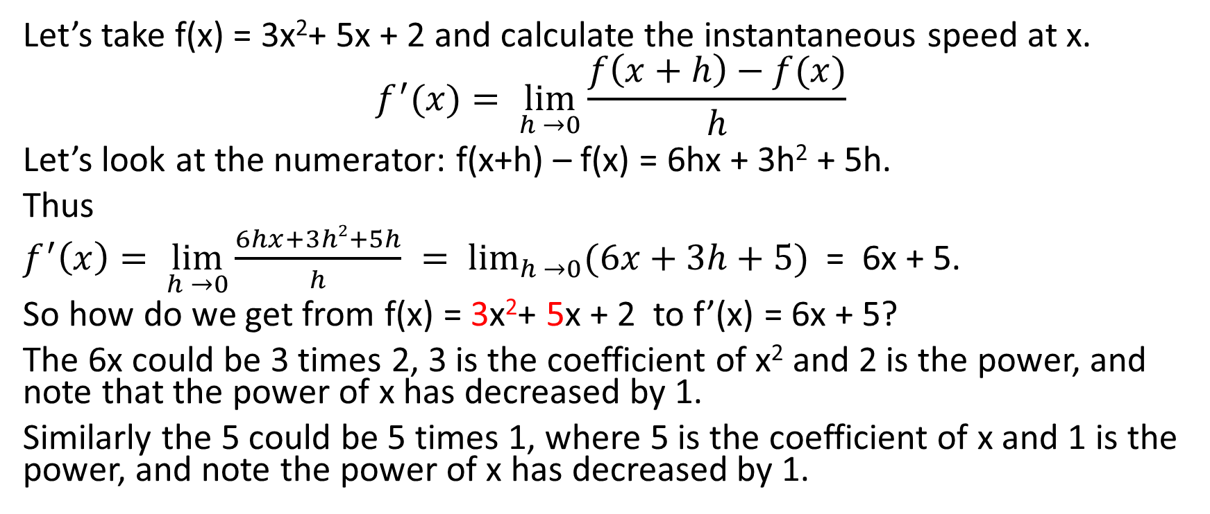
Instantaneous Speed for Quadratic Functions
Let’s take f(x) = 3x²+ 5x + 2 and calculate the instantaneous speed at x.
$$f^{′}(x)= \lim_{h →0}{\frac{f\left(x+h\right)−f(x)}{h}}$$
Let’s look at the numerator: f(x+h) – f(x) = 6hx + 3h² + 5h.
Thus
$f^{′}\left(x\right)= \lim_{h →0}{\frac{6hx+3h2+5h}{h}} = \lim_{h →0}{(6x+3h+5)}$ = 6x + 5.
So how do we get from f(x) = 3x²+ 5x + 2 to f’(x) = 6x + 5?
The 6x could be 3 times 2, 3 is the coefficient of x² and 2 is the power, and note that the power of x has decreased by 1.
Similarly the 5 could be 5 times 1, where 5 is the coefficient of x and 1 is the power, and note the power of x has decreased by 1.

Slide 58
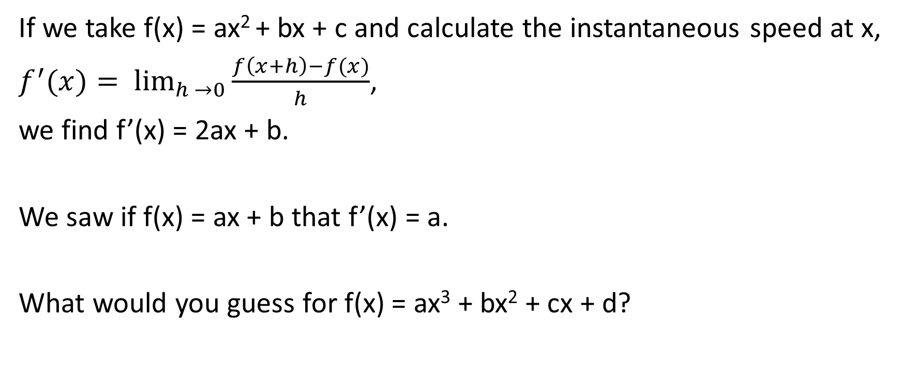
Instantaneous Speed for Quadratic Functions
If we take f(x) = ax² + bx + c and calculate the instantaneous speed at x,
$f^{′}(x)= \lim_{h →0}{\frac{f\left(x+h\right)−f(x)}{h}}$,
we find f’(x) = 2ax + b.
We saw if f(x) = ax + b that f’(x) = a.
What would you guess for f(x) = ax³ + bx² + cx + d?

Slide 59
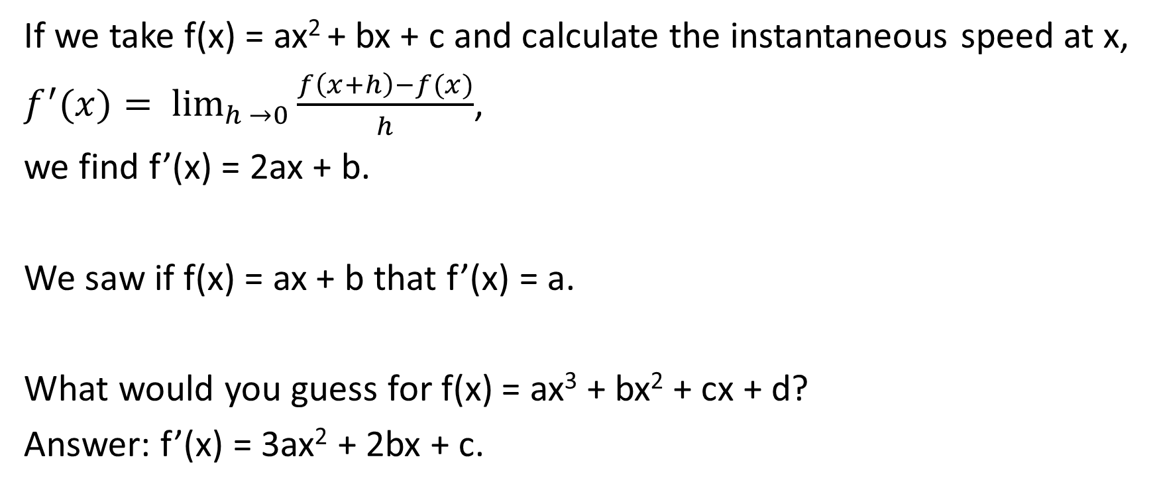
Instantaneous Speed for Quadratic Functions
If we take f(x) = ax² + bx + c and calculate the instantaneous speed at x,
$f^{′}(x)= \lim_{h →0}{\frac{f\left(x+h\right)−f(x)}{h}}$,
we find f’(x) = 2ax + b.
We saw if f(x) = ax + b that f’(x) = a.
What would you guess for f(x) = ax³ + bx² + cx + d?
Answer: f’(x) = 3ax² + 2bx + c.

Slide 60
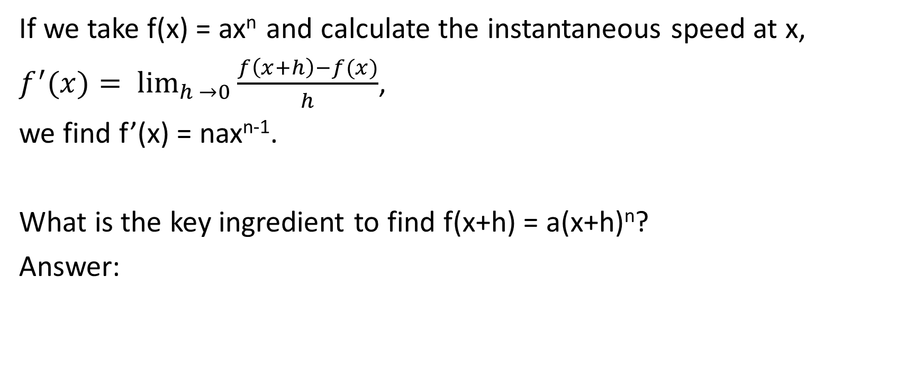
Instantaneous Speed for Polynomials
If we take f(x) = ax^{n} and calculate the instantaneous speed at x,
$f^{′}(x)= \lim_{h →0}{\frac{f\left(x+h\right)−f(x)}{h}}$,
we find f’(x) = nax^{n-1}.
What is the key ingredient to find f(x+h) = a(x+h)^{n}?
Answer:

Slide 61
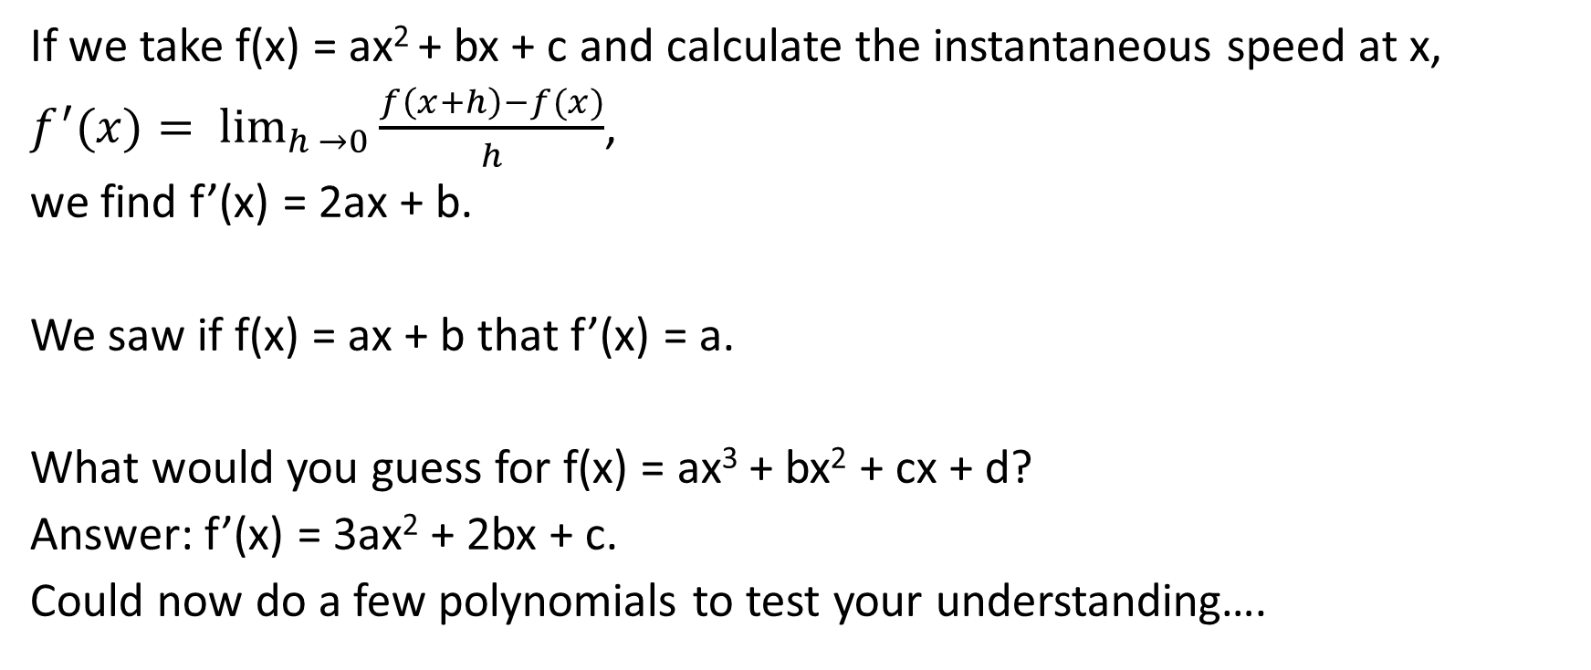
Instantaneous Speed for Quadratic Functions
If we take f(x) = ax² + bx + c and calculate the instantaneous speed at x,
$f^{′}(x)= \lim_{h →0}{\frac{f\left(x+h\right)−f(x)}{h}}$,
we find f’(x) = 2ax + b.
We saw if f(x) = ax + b that f’(x) = a.
What would you guess for f(x) = ax³ + bx² + cx + d?
Answer: f’(x) = 3ax² + 2bx + c.
Could now do a few polynomials to test your understanding….

Slide 62
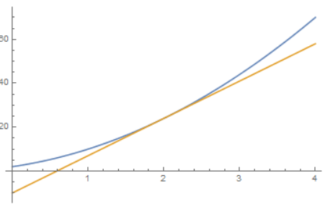
Why do we care?
We can use the instantaneous speed to approximate the function.
We showed if f(x) = 3x²+ 5x + 2 then f’(x) = 6x + 5.
Consider the point x=2. Have f(2) = 12 + 10 + 2 = 24.
The instantaneous speed there is f’(2) = 12 + 5 = 17.
We can draw the tangent line at this point, using point-slope.
Point: (2, f(2)) = (2, 24) and slope m = f’(2) = 17.
Thus line is y – 24 = 17(x-2) or y = 17x – 10.

Slide 63
Why do we care?
We can use the instantaneous speed to approximate the function.
We showed if f(x) = 3x²+ 5x + 2 then f’(x) = 6x + 5.
Consider the point x=2. Have f(2) = 12 + 10 + 2 = 24.
The instantaneous speed there is f’(2) = 12 + 5 = 17.
We can draw the tangent line at this point, using point-slope.
Point: (2, f(2)) = (2, 24) and slope m = f’(2) = 17.
Thus line is y – 24 = 17(x-2) or y = 17x – 10.
Are you surprised the tangent line is a good approximation near x=2? Why?

Slide 64
PART IV:
Divide and Conquer versus Newton’s Method

Slide 65
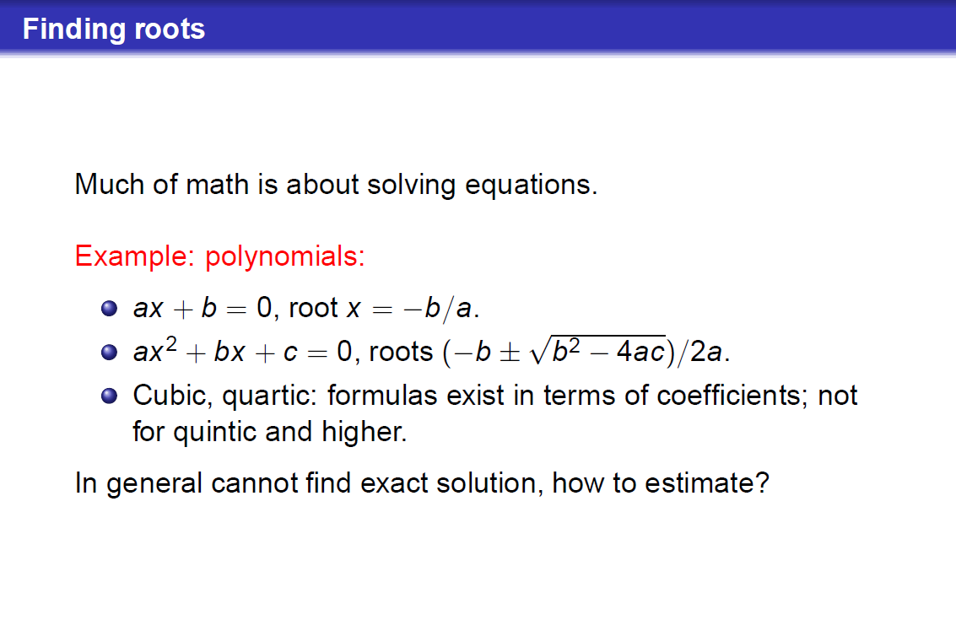

Slide 66
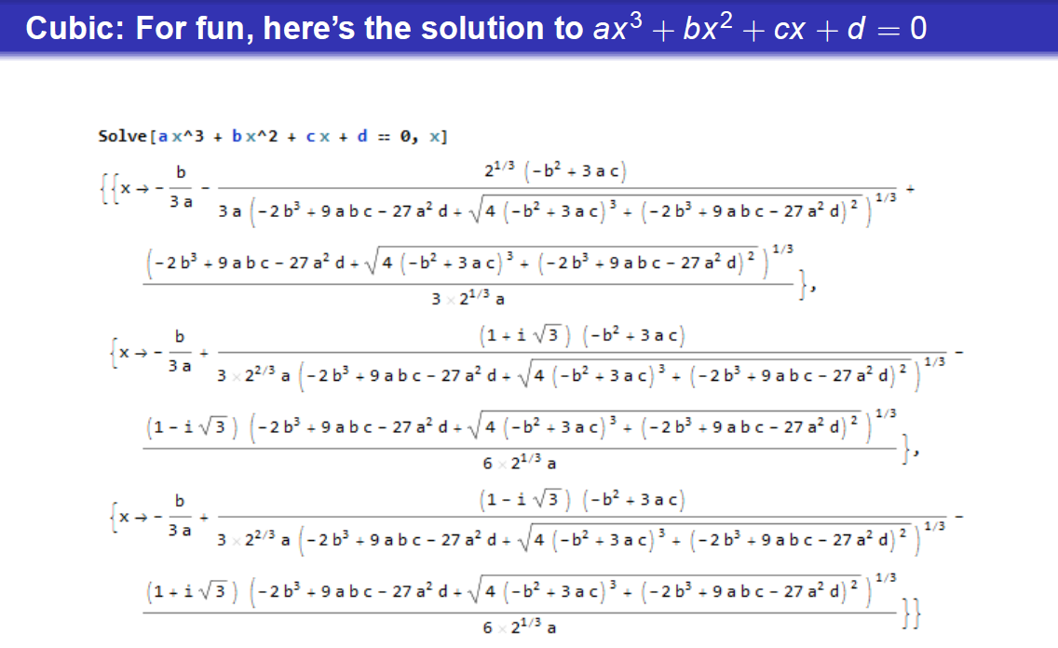

Slide 67
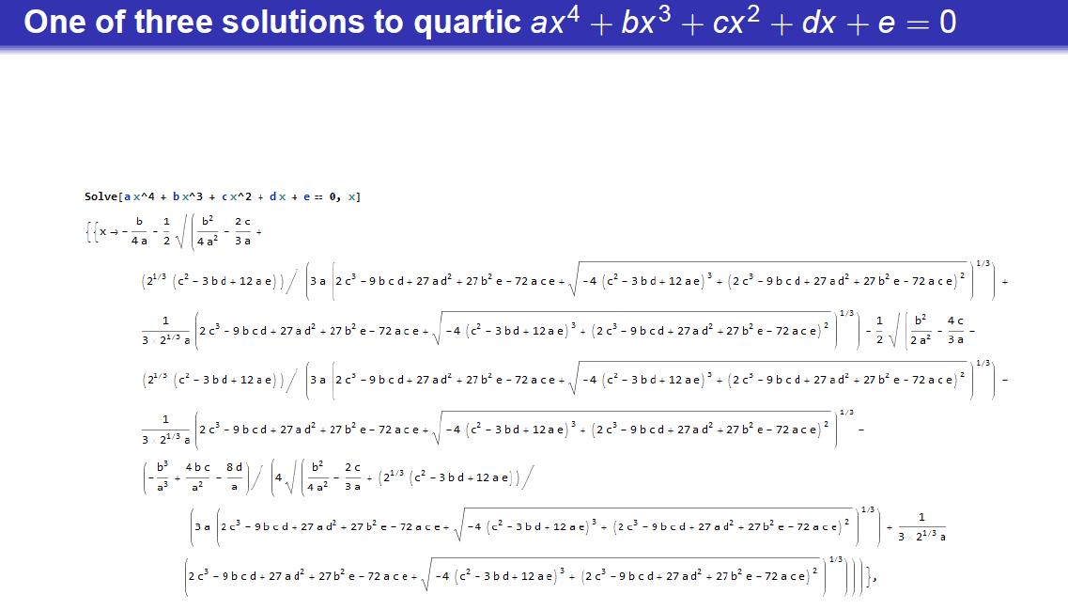


Slide 68
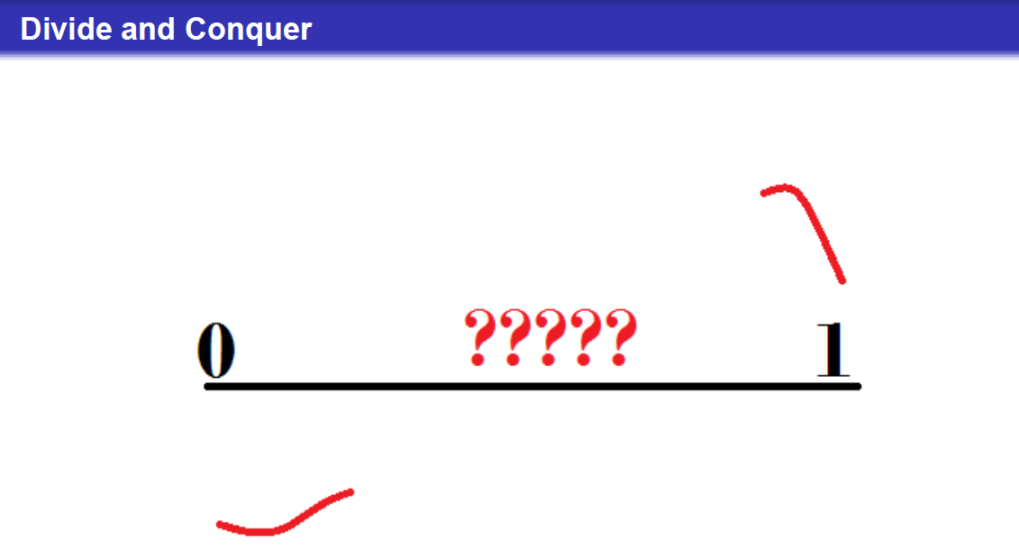

Slide 69
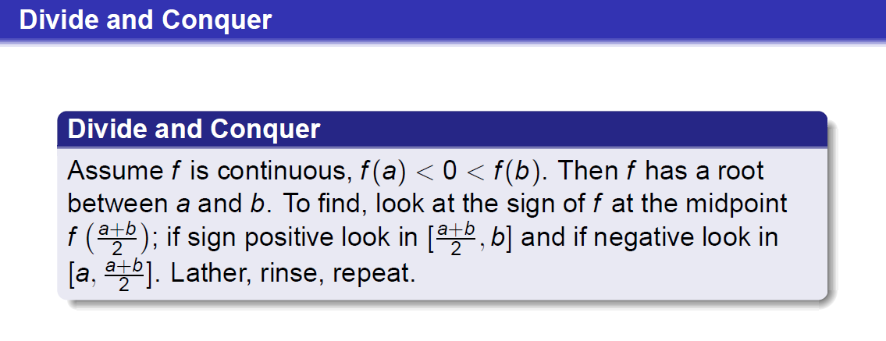


Notation: [a, b] means the interval from a to b: it is all x such that a ≤ x ≤ b. Thus [0,1] is all real numbers from 0 to 1.

Slide 70


Slide 71


Slide 72


Slide 73


Slide 74

Newton’s Method: Finding the next guess
Say have f(x) = x² – 3
Want to solve f(x) = 0
Roots are

Slide 75

Newton’s Method: Finding the next guess
Say have f(x) = x² – 3
Want to solve f(x) = 0
Roots are $\sqrt{3} and −\sqrt{3}$.
But what are these numbers?
How can we approximate them?
Idea is to replace the quadratic curve y = f(x) with a straight line.
Go from first guess to second, then shampoo math: lather, rinse, repeat.

Slide 76

Newton’s Method: Finding the next guess
Solve f(x) = x² – 3 = 0, roots are $\sqrt{3} and −\sqrt{3}$.
Initial guess x₀ = 2.
If we plug in x=2 we get f(2) =

Slide 77

Newton’s Method: Finding the next guess
Solve f(x) = x² – 3 = 0, roots are $\sqrt{3} and −\sqrt{3}$.
Initial guess x₀ = 2.
If we plug in x=2 we get f(2) = 1.
This is NOT zero, so we have NOT found the root.
What is f’(x)? It is f’(x) =

Slide 78

Newton’s Method: Finding the next guess
Solve f(x) = x² – 3 = 0, roots are $\sqrt{3} and −\sqrt{3}$.
Initial guess x₀ = 2.
If we plug in x=2 we get f(2) = 1.
This is NOT zero, so we have NOT found the root.
What is f’(x)? It is f’(x) = 2x.
Thus what is the instantaneous speed at x=2? It is f’(2) =

Slide 79

Newton’s Method: Finding the next guess
Solve f(x) = x² – 3 = 0, roots are $\sqrt{3} and −\sqrt{3}$.
Initial guess x₀ = 2.
If we plug in x=2 we get f(2) = 1.
This is NOT zero, so we have NOT found the root.
What is f’(x)? It is f’(x) = 2x .
Thus what is the instantaneous speed at x=2? It is f’(2) = 4.
Now we find the tangent line here.

Slide 80

Newton’s Method: Finding the next guess
Solve f(x) = x² – 3 = 0, roots are $\sqrt{3} and −\sqrt{3}$.
Initial guess x₀ = 2, f(2) = 1, f’(2) = 4.
Use Point-Slope to get line.
Point: (2,f(2)) = (2,1)
Slope: m = f’(2) = 4.
Equation:

Slide 81

Newton’s Method: Finding the next guess
Solve f(x) = x² – 3 = 0, roots are $\sqrt{3} and −\sqrt{3}$.
Initial guess x₀ = 2, f(2) = 1, f’(2) = 4.
Use Point-Slope to get line.
Point: (2,f(2)) = (2,1)
Slope: m = f’(2) = 4.
Equation: y – 1 = 4(x-2).
Simplify to y = 4x-7.
Where does this line hit the x-axis?

Slide 82

Newton’s Method: Finding the next guess
Solve f(x) = x² – 3 = 0, roots are $\sqrt{3} and −\sqrt{3}$.
Initial guess x₀ = 2, f(2) = 1, f’(2) = 4.
Use Point-Slope to get line.
Point: (2,f(2)) = (2,1)
Slope: m = f’(2) = 4.
Equation: y – 1 = 4(x-2).
Simplify to y = 4x-7.
Where does this line hit the x-axis?
0 = 4x-7 so 4x = 7 so x = 7/4 = 1.75.

Slide 83

Newton’s Method: Finding the next guess
Solve f(x) = x² – 3 = 0, roots are $\sqrt{3} and −\sqrt{3}$.
We had x₀ = 2 our initial guess.
New guess for root is x₁ = 7/4 = 1.75.
Not terrible.
Try again. Use x₁ = 7/4, and find a NEW tangent line….

Slide 84

Newton’s Method: Finding the next guess
Solve f(x) = x² – 3 = 0, roots are $\sqrt{3} and −\sqrt{3}$.
New guess for root is x₁ = 7/4 = 1.75.
Point: (7/4, f(7/4)) = (7/4, 49/16-3)
Slope: m = f’(7/4) = 7/2 as f’(x) = 2x.
Simplify:
Point is (7/4, 1/16), slope is 7/2.
As y-coordinate almost 0 see CLOSE to the root….

Slide 85


Newton’s Method: Finding the next guess
Solve f(x) = x² – 3 = 0, roots are $\sqrt{3} and −\sqrt{3}$.
New guess for root is x₁ = 7/4 = 1.75.
Point: (7/4, f(7/4)) = (7/4, 1/16)
Slope: m = f’(7/4) = 7/2 as f’(x) = 2x.
Line: y – 1/16 = (7/2)(x – 7/4).
Where does this hit the x-axis?

Slide 86

Newton’s Method: Finding the next guess
Solve f(x) = x² – 3 = 0, roots are $\sqrt{3} and −\sqrt{3}$.
New guess for root is x₁ = 7/4 = 1.75.
Point: (7/4, f(7/4)) = (7/4, 1/16)
Slope: m = f’(7/4) = 7/2 as f’(x) = 2x.
Line: y – 1/16 = (7/2)(x – 7/4).
Where does this hit the x-axis? At y = 0.
Get -1/16 = (7/2)x – 49/8

Slide 87

Newton’s Method: Finding the next guess
Solve f(x) = x² – 3 = 0, roots are $\sqrt{3} and −\sqrt{3}$.
New guess for root is x₁ = 7/4 = 1.75.
Point: (7/4, f(7/4)) = (7/4, 1/16)
Slope: m = f’(7/4) = 7/2 as f’(x) = 2x.
Line: y – 1/16 = (7/2)(x – 7/4).
Where does this hit the x-axis? At y = 0.
Get -1/16 = (7/2)x – 49/8
So (7/2)x = 97/16, or x = 97/56
So next guess x₂ is 97/56 or about 1.7321428571.

Slide 88

Newton’s Method: Finding the next guess
Solve f(x) = x² – 3 = 0, roots are $\sqrt{3} and −\sqrt{3}$.
New guess for root is x₂ = 97/56 or about 1.7321428571.
We can keep doing this.
We get a sequence of points x₁, x₂, x₃, ….
Do these converge to $\sqrt{3}$? Looks like it!
Doing some algebra we can come up with
an explicit formula for x_{n+1} in terms of x_{n}.

Slide 89


Slide 90


Slide 91


Slide 92


Slide 93

https://www.youtube.com/watch?v=ZsFixqGFNRc

Slide 94


Slide 95


Slide 96

https://www.youtube.com/watch?v=ZsFixqGFNRc

Slide 97


Slide 98


Slide 99

Mandelbrot Links: Especially GOOD LINKS
https://www.youtube.com/watch?v=0jGaio87u3A
https://www.youtube.com/watch?v=9j2yV1nLCEI
https://www.youtube.com/watch?v=ZsFixqGFNRc
https://www.youtube.com/watch?v=PD2XgQOyCCk
https://www.youtube.com/watch?v=vfteiiTfE0c

